Slide 2
Embedded Development Application Note: Endian-Independence
Patrick Rogers
15 November 2018

Slide 3
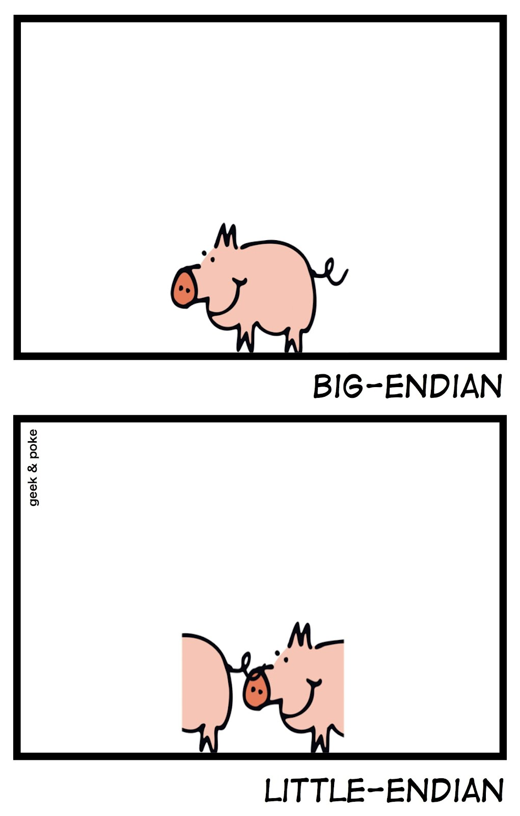
The Issue
Without being technical yet …
… or fair

Slide 4
Why Do We Care?
An external entity may require a non-native representation
Passing data from one machine to another over a network
Memory-mapped devices
Specific file formats
JPEG files use big-endian format
GIF files use little-endian format
Others…
A new target may not have required layout by default

Slide 5
Historical Approaches Are Problematic
Attempt to use a single record representation clause
Multiple versions in multiple source files with one selected for builder
Conditional compilation in single file
Norm Cohen’s coding “trick” in a single file, works but hard to read
Manual byte swapping wherever needed
Not robust, makes code complex
Other approaches based on code changes, still manual

Slide 6
Some Nomenclature

Slide 7
“Endian” Byte Ordering
Big-Endian: High order byte is in lowest address
Storage Unit
Storage Unit
Storage Unit
Storage Unit
0
1
2
3
High-Order Bits
Low-Order Bits
3
2
1
0
Storage Unit
Storage Unit
Storage Unit
Storage Unit
Little-Endian: Low order byte is in lowest address

Slide 8
“Machine Scalars”
A unit of storage that can be efficiently manipulated by hardware instructions
Consists of an integral number of storage elements
In various sizes, depending on machine architecture
A “word” or “half-word” or …
When reading/writing components of composite types, the compiler loads/stores machine scalars, with shifting & masking as necessary

Slide 9
Representing Bit Ordering In Ada
A type declared in package System
type Bit_Order is (High_Order_First, Low_Order_First);
High_Order_First (“High Order Bit Zero”)
Big-Endian: High order bit is in bit zero
0
31
High-Order Bits
Low-Order Bits
31
0
Low_Order_First (“Low Order Bit Zero”)
Little-Endian: Low order bit is in bit zero

Slide 10
The Native Bit Order
Represented by a constant declared in package System
Value depends on the optimum machine scalar “word”
If a word is a single storage unit then value is implementation-defined since effect is local to a storage unit
If a word consists of multiple storage units then value is same as byte endian order
Default_Bit_Order : constant Bit_Order := implementation-defined-value;

Slide 11
Illustration Code

Slide 12
subtype Years is Natural range 0 .. 127;
subtype Months is Natural range 1 .. 12;
subtype Days is Natural range 1 .. 31;
type Date is record
Years_Since_1980 : Years;
Month : Months;
Day : Days;
end record;
for Date use record
Years_Since_1980 at 0 range 0 .. 6;
Month at 0 range 7 .. 10;
Day at 0 range 11 .. 15;
end record;
Interpretation depends on native order
On A Big-Endian Machine
0
1
2
3
4
5
6
7
8
9
A
B
C
D
E
F
Y
Y
Y
Y
Y
Y
Y
M
M
M
M
D
D
D
D
D
On A Little-Endian Machine
F
E
D
C
B
A
9
8
7
6
5
4
3
2
1
0
D
D
D
D
D
M
M
M
M
Y
Y
Y
Y
Y
Y
Y

Slide 13
Big-Endian Memory Representation
subtype Years is Natural range 0 .. 127;
subtype Months is Natural range 1 .. 12;
subtype Days is Natural range 1 .. 31;
type Date is record
Years_Since_1980 : Years;
Month : Months;
Day : Days;
end record;
for Date use record
Years_Since_1980 at 0 range 0 .. 6;
Month at 0 range 7 .. 10;
Day at 0 range 11 .. 15;
end record;
Representation In Memory
Storage Unit
Storage Unit
Storage Unit Offset
0
1
Bit #
0
1
2
3
4
5
6
7
8
9
A
B
C
D
E
F
Component
Y
Y
Y
Y
Y
Y
Y
M
M
M
M
D
D
D
D
D
Binary Value
0
1
0
0
0
0
0
1
1
0
0
0
1
1
0
0
Hex Value
4
1
8
C
Value : constant Date := (Years_Since_1980 => 32, Month => 12, Day => 12); -- December 12th, 2012

Slide 14
Little-Endian Memory Representation
subtype Years is Natural range 0 .. 127;
subtype Months is Natural range 1 .. 12;
subtype Days is Natural range 1 .. 31;
type Date is record
Years_Since_1980 : Years;
Month : Months;
Day : Days;
end record;
for Date use record
Years_Since_1980 at 0 range 0 .. 6;
Month at 0 range 7 .. 10;
Day at 0 range 11 .. 15;
end record;
Representation In Memory
Storage Unit
Storage Unit
Storage Unit Offset
1
0
Bit #
F
E
D
C
B
A
9
8
7
6
5
4
3
2
1
0
Component
D
D
D
D
D
M
M
M
M
Y
Y
Y
Y
Y
Y
Y
Binary Value
0
1
1
0
0
1
1
0
0
0
1
0
0
0
0
0
Hex Value
6
6
2
0
Value : constant Date := (Years_Since_1980 => 32, Month => 12, Day => 12); -- December 12th, 2012

Slide 15
Big-Endian Layout Viewed On L-E Machine
Low-order Byte
High-order Byte
0
1
2
3
4
5
6
7
8
9
A
B
C
D
E
F
Big Endian Layout
Y
Y
Y
Y
Y
Y
Y
M
M
M
M
D
D
D
D
D
0
1
0
0
0
0
0
1
1
0
0
0
1
1
0
0
High-order Byte
Low-order Byte
Storage Unit
Storage Unit
1
0
F
E
D
C
B
A
9
8
7
6
5
4
3
2
1
0
Discontinuous field!
M
M
M
D
D
D
D
D
Y
Y
Y
Y
Y
Y
Y
M
1
0
0
0
1
1
0
0
0
1
0
0
0
0
0
1
8
C
4
1
Representation In L-E Memory

Slide 16
What To Do?
Discontinuous bit range cannot be expressed in representation
Specifying Date'Bit_Order alone doesn’t help
Specifies only the bit numbering within machine scalars for the purpose of expressing a record representation clause
Does not affect order in which the bytes that constitute machine scalars are written to/read from memory
High_Order_First bit #
within machine scalar
0
1
2
3
4
5
6
7
8
9
A
B
C
D
E
F
Y
Y
Y
Y
Y
Y
Y
M
M
M
M
D
D
D
D
D

Slide 17
Solution

Slide 18
GNAT Attribute Scalar_Storage_Order
Applicable to array types and record types
Indicates a chosen memory byte order, independent of native endianness
But may be the same as native!
Takes values from type System.Bit_Order
type Date is record
Years_Since_1980 : Years;
Month : Months;
Day : Days;
end record with
…
Scalar_Storage_Order => High_Order_First;

Slide 19
Compiler Action for Non-Native Order
When a scalar component is read from memory, compiler reverses the bytes in enclosing machine scalar before retrieving the component from that machine scalar
The opposite is done when writing a scalar component to memory
load 16-bit word from Value'Address
swap bytes within word
mask word with bits of Month component
shift result to low-order bits of word
copy word to M
M : Months := Value.Month;

Slide 20
Solution Source & L-E Generated Code
subtype Years is Natural range 0 .. 127;
subtype Months is Natural range 1 .. 12;
subtype Days is Natural range 1 .. 31;
type Date is record
Years_Since_1980 : Years;
Month : Months;
Day : Days;
end record with
Bit_Order => High_Order_First,
Scalar_Storage_Order => High_Order_First;
for Date use record
Years_Since_1980 at 0 range 0 .. 6;
Month at 0 range 7 .. 10;
Day at 0 range 11 .. 15;
end record;
Low-order Byte
High-order Byte
0
1
2
3
4
5
6
7
8
9
A
B
C
D
E
F
Machine Scalar
Y
Y
Y
Y
Y
Y
Y
M
M
M
M
D
D
D
D
D
0
1
0
0
0
0
0
1
1
0
0
0
1
1
0
0
Bytes swapping on
memory read/write
Storage Unit
Storage Unit
1
0
F
E
D
C
B
A
9
8
7
6
5
4
3
2
1
0
M
M
M
D
D
D
D
D
Y
Y
Y
Y
Y
Y
Y
M
1
0
0
0
1
1
0
0
0
1
0
0
0
0
0
1
8
C
4
1
Representation In L-E Memory

Slide 21
Rules for Scalar_Storage_Order
Must have same value as type’s Bit_Order
Either by default or by specification
Compiler error otherwise
Hence best practice is to specify both if specifying Scalar_Storage_Order
Doesn’t apply to nested composite component types…
They would have their own, if needed
Specific rules for derived types and type extensions…
Others, e.g., no component larger than largest machine scalar

Slide 22
Pragma Default_Scalar_Storage_Order
Defined by GNAT
Overrides default native ordering of the target for scalars within array and record types
Can be applied locally to a package spec or in a declarative part
Can be applied to entire partition via configuration pragma
Binder ensures consistent use throughout
Be careful! May significantly degrade run-time performance!

Slide 23
Querying the Byte Order
GNAT-defined attribute
Returns current value of the default scalar storage order
Of type System.Bit_Order
As speciﬁed using pragma Default_Scalar_Storage_Order
Otherwise equal to System.Default_Bit_Order
Standard'Default_Scalar_Storage_Order

Slide 24
Takeaway
You can now easily specify endian-independent layouts
But mechanism is not standard so not portable across vendors
No changes expected for Ada 2020
Not a new capability but seems to be largely unknown
See GNAT Reference Manual entry for “Attribute Scalar_Storage_Order”
See Gem #140 for an expanded discussion
https://www.adacore.com/gems/gem-140-bridging-the-endianness-gap/
See 2013 Ada Europe paper “Lady Ada Mediates Peace Treaty in Endianness War” by Thomas Quinot, Eric Botcazou of AdaCore

Slide 25
Questions?

