Slide 3
Easy Ada tooling with Libadalang
Raphaël Amiard

Slide 4
Previous episodes - What is libadalang
A library that allows users to query/alter data about Ada sources
Both low & high level APIs:
What is the type of this expression?
How many references to this variable?
Give me the source location of this token
Rename this entity
Multi-language: Easy binding generation to other languages/ecosystems
Today: Python, Ada, C
Easy scripting: Be able to create a prototype quickly & interactively

Slide 5
WRT. ASIS
Implementation benefits
Incremental
Error recovery
Syntax only
Semantic tolerance
Adapted for long running apps
API benefits
Higher level API
Bindings to other languages
Tree rewriting
Global XREFs

Slide 6
API Part 1: Tokens
Code | Outputs
-- main.adb procedure Main is null; | Token: <Token Procedure u'procedure' at 1:1-1:10> Token: <Token Identifier u'Main' at 1:11-1:15> Token: <Token Is u'is' at 1:16-1:18> Token: <Token Null u'null' at 1:19-1:23> Token: <Token Semicolon u';' at 1:23-1:24>
ctx = lal.AnalysisContext() unit = ctx.get_from_file('main.adb') for token in unit.root.tokens: print 'Token: {}'.format(token)

Slide 7
API Part 2: Syntax
Code | Outputs
-- main.adb procedure Main is A : Integer := 12; B, C : Integer := 15; begin A := B + C; end Main; | 2:4-2:22 A : Integer := 12; 3:4-3:25 B, C : Integer := 15;
for o in unit.root.findall(lal.ObjectDecl): print o.sloc_range, o.text

Slide 8
API Part 3: Semantic
Code | Outputs
with Ada.Text_IO; use Ada.Text_IO; procedure Main is function Double (I : Integer) return Integer is (I * 2); function Double (I : Float) return Float is (I * 2.0); begin Put_Line (Integer'Image (Double (12))); end Main; | function Double (I : Integer) return Integer is (I * 2);
double_call = unit.root.find( lambda n: n.is_a(lal.CallExpr) and n.f_name.text == 'Double' ) print double_call.f_name.p_referenced_decl.text

Slide 9
API Part 4: Tree rewriting (WIP)
Code | Outputs
procedure Main is begin Put_Line ("Hello world"); end Main; | procedure Main is begin Put_Line ("Bye world"); end Main;
call = unit.root.find(lal.CallExpr) # Find the call diff = ctx.start_rewriting() # Start a rewriting # Get the param of the call param_diff = diff.get_node(call.f_suffix[0]) # Replace the expression of the parameter with a new # node param_diff.f_expr = lal.rewriting.StringLiteral( '"Bye world"' ) diff.apply()

Slide 10
An example checker
import sys import libadalang as lal def check_ident(ident): if not ident.text[0].isupper(): print '{}:{}: variable name "{}" should be capitalized'.format( ident.unit.filename, ident.sloc_range.start, ident.text ) ctx = lal.AnalysisContext() for filename in sys.argv[1:]: u = ctx.get_from_file(filename) for d in u.diagnostics: print '{}:{}'.format(filename, d) if u.root: for decl in u.root.findall(lal.ObjectDecl): for ident in decl.f_ids: check_ident(ident)

Slide 11
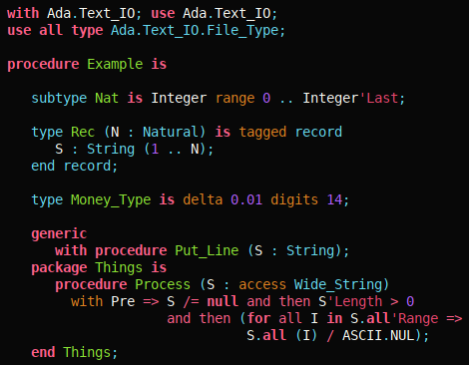
Demo HTML Syntax highlighter + Xrefs

Slide 12
Syntax based static analyzers
def has_same_operands(binop): def same_tokens(left, right): return len(left) == len(right) and all( le.is_equivalent(ri) for le, ri in zip(left, right) ) return same_tokens(list(binop.f_left.tokens), list(binop.f_right.tokens)) def interesting_oper(op): return not op.is_a(lal.OpMult, lal.OpPlus, lal.OpDoubleDot, lal.OpPow, lal.OpConcat)) for b in unit.root.findall(lal.BinOp): if interesting_oper(b.f_op) and has_same_operands(b): print 'Same operands for {} in {}'.format( b, source_file )
Those 20 lines of code found:
1 bug in GNAT
3 bugs in CodePeer
1 bug in GPS
despite extensive testing and static analysis.
More complex checkers based on the same approach being integrated into Codepeer.

Slide 13
Semantic based static analyzers
with Ada.Text_IO; use Ada.Text_IO; procedure Main is Input : File_Type; begin Open (File => Input, Mode => In_File, Name => "input.txt"); while not End_Of_File (Input) loop declare Line : String := Get_Line (Input); -- WARNING: File might be closed begin Put_Line (Line); Close (Input); -- WARNING: File might be closed end; end loop; end Main;
Very simple and targeted abstract interpretation
DSL to specify new checkers
Work in progress!
Some of the work is being integrated into Codepeer
https://github.com/AdaCore/lal-checkers

Slide 14
Already used in&out of AdaCore
This year
GNATpp
Up to 10x time faster
Error tolerance
--syntax-only mode
GNATstub
Incremental mode
GNATmetric
New metrics
Next year
IDEs
Syntax highlighting
Xrefs
Completion
Microsoft LSP: Support for many editors
Clients using it already:
Code instrumentation
Automatic refactorings
Generation of serializers/deserializers

Slide 15
Conclusion
Sources are on GitHub
Come open issues and create pull requests!
First stable version in upcoming release
API will be incrementally improved after that
We’ll try to avoid breakage as much as possible
But allow ourselves to make it better for the future :)
What do you want to build with Libadalang ? :)

