Slide 2
Ada/SPARK Community
Raphaël Amiard

Slide 3
We all need a strong Ada/SPARK community

Slide 4
Why?
Grow the pool of engineers that you can recruit for your Ada/SPARK project
Increase the number and quality of learning material that you can use to train your engineers
Grow the number of OSS projects that you use/start from
Support your choice of Ada/SPARK in the long term

Slide 5
Ada/SPARK perception changing

Slide 6
In the past 8 months:
Stack Overflow:
Followers: 1032 +13%
Questions asked: 1515 +7%
GitHub Ada projects: 2381 +13%
Twitter followers 477 +38%
Ada Reddit followers 1975 +100%
Community metrics

Slide 7
Enhancing Ada/SPARK learning experience

Slide 8
What we did so far
Books:
Programming in Ada
Ada rationale
Ada for the C++ and Java developer
Implementation Guidance for the Adoption of SPARK
Etc.
E-learning:
AdaCore University

Slide 9
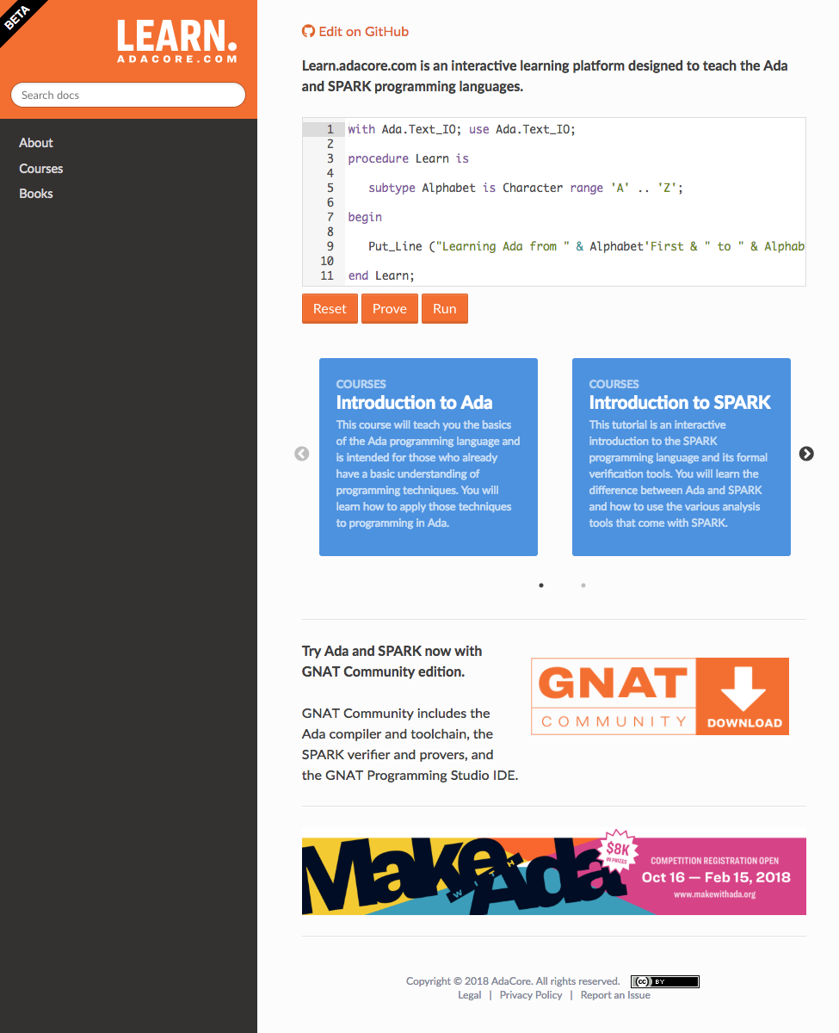
Enhancement of Ada/SPARK learning experience
2 courses, 1 book
For customers and community
Feedback from the training field
Live demo!

Slide 10
Behind the scene
Interactive widget
Based on textual and open format
Can generate different outputs (website, pdf)
Hosted on GitHub

Slide 11
AdaCore U material is now on YouTube
youtube.com/user/AdaCore05
and GitHub
github.com/AdaCoreU/Courses

Slide 14
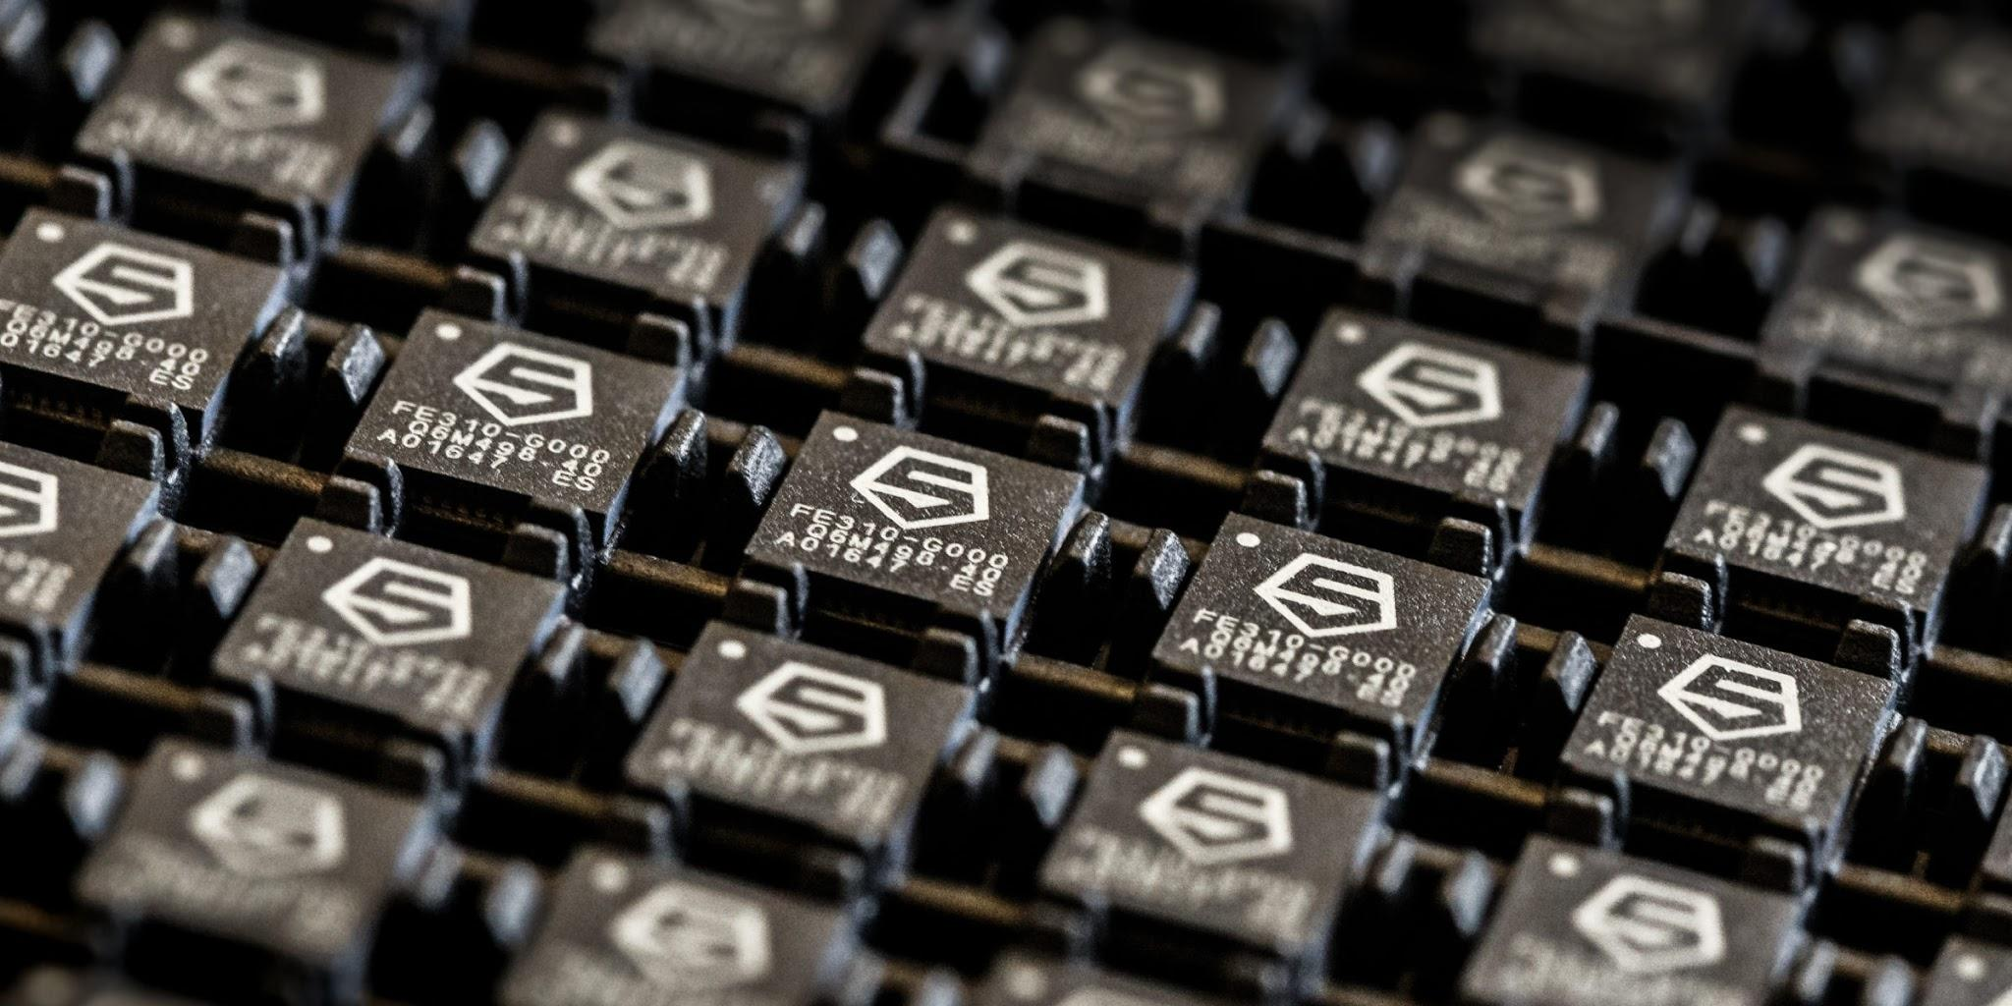

Slide 15
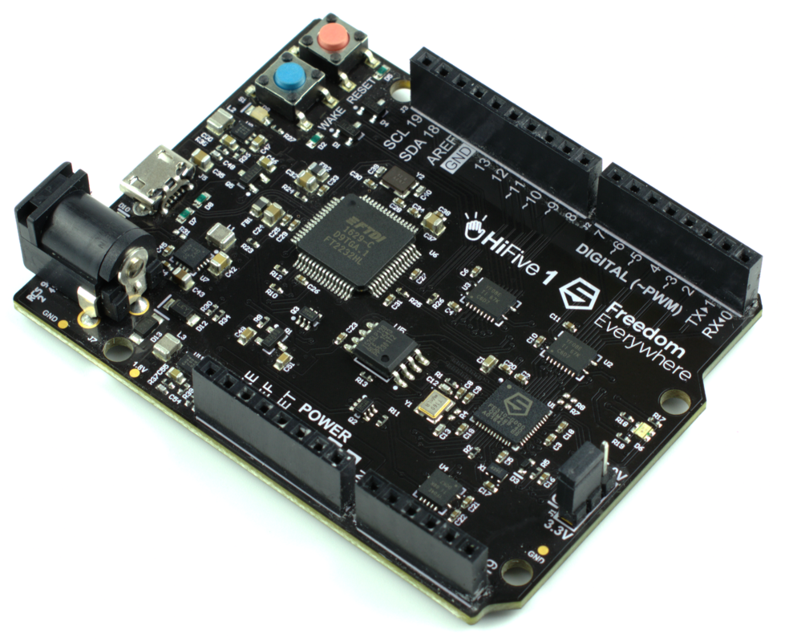
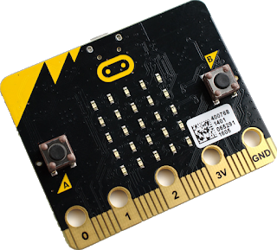

Slide 16
Community events

Slide 17
+

Slide 18
FOSDEM

Slide 19
2019 Roadmap

Slide 20
A source package manager for Ada / SPARK

Slide 23
211 university members
664 academic contacts
*Now open to PhD and Master’s students*

Slide 24
Twitter @AdaProgrammers
reddit.com/r/ada
github.com/trending/ada
Stack Overflow
comp.lang.ada
IRC #ada
Gitter ada-lang

