Slide 2
Why Switch to a Later Version of Ada?
Patrick Rogers
15 November 2018

Slide 3
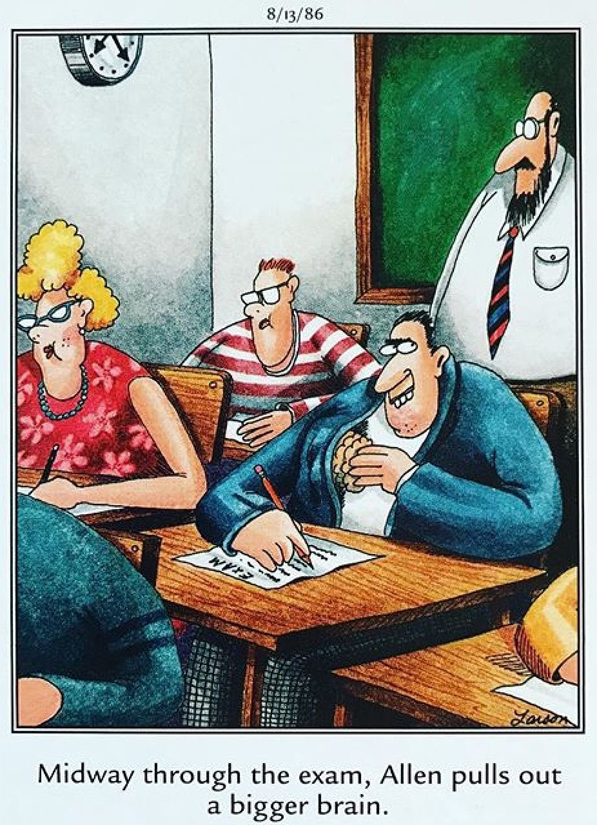
Because changing people is difficult & expensive

Slide 4
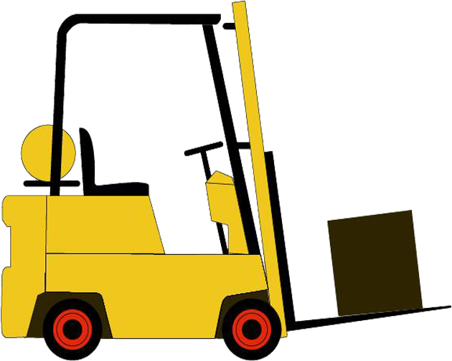
A Later Version of Ada
One of the things you can control
Productivity gains are expected to outweigh risks
Gains are due to greater expressive power
Doing better what we could already do somewhat
Doing what we could not really do before

Slide 5
Ada Evolution Highlights
Ada 2012
Contracts
Iterators
Flexible Expressions
More Containers
More Real-Time Support
Ada 2005
Multiple Inheritance
Containers
Useful Limited Types
More Real-Time
Ravenscar
Ada 95
Efficient synchronization
OOP
Better Access Types
Child Packages
Annexes
Ada 83
Abstract Data Types
Modules
Concurrency
Generics
Exceptions
etc.

Slide 6
Contracts Example
procedure Push (This : in out Stack; Value : in Content) with
Pre => not Full (This),
Post => not Empty (This)
and Top (This) = Value
and Extent (This) = Extent (This'Old) + 1
and Unchanged (This'Old, Within => This);
…
function Full (This : Stack) return Boolean;
function Empty (This : Stack) return Boolean;
function Top (This : Stack) return Content with
Pre => not Empty (This);
function Extent (This : Stack) return Content_Count;
function Unchanged (Invariant_Part, Within : Stack) return Boolean;
Checked at
Run-Time
Low-Level
Requirements

Slide 7
Ada 202x (where x = 0)
Fine-grained parallelism for multicore architectures
More contracts
Richer expressions
New profile based on relaxed Ravenscar
And several other enhancements…

Slide 8
Parallel Block and Loop Examples
procedure Traverse (T : Expr_Ptr) is
begin
if T /= null and then T.all in Binary_Operation'Class
then -- recurse down the binary tree
parallel do
Traverse (T.Left);
and
Traverse (T.Right);
and
Put_Line ("Processing " & Expanded_Name (T'Tag));
end do;
end if;
end Traverse;
Grid : array (1 .. 80, 1 .. 100) of Boolean;
parallel for K in Grid'Range(1) loop
Grid (K, 1) := (for all J in Grid'Range (2) =>
Grid (K,J) = True);
end loop;
Separate threads

Slide 9
The Jorvik Profile
A new profile based on Ravenscar
Not a replacement for Ravenscar!
Intended for cases in which most stringent analyses not required
Provides significant expressive power gain
Many/most protected object idioms now allowed
Predictability and efficiency retained
Schedulability analysis retained
Currently implemented as GNAT_Extended_Ravenscar profile
On selected platforms

Slide 10
Jorvik Allowed PO Content Example
protected body Bounded_Buffer is
entry Put (Item : in Element) when Count /= Capacity is
begin
Values (Next_In) := Item;
Next_In := (Next_In mod Capacity) + 1;
Count := Count + 1;
end Put;
entry Get (Item : out Element) when Count > 0 is
begin
Item := Values (Next_Out);
Next_Out := (Next_Out mod Capacity) + 1;
Count := Count - 1;
end Get;
…
end Bounded_Buffer;
Multiple Entries
per PO
More Content
per Barrier
Multiple Queued
Callers per
Entry

Slide 11
Benefits? Don’t Believe Us
MITRE
Annual Average Costs for Software Maintenance, 1994
Steve Zeigler
Comparing Development Costs of C and Ada, March 30, 1995
Capers Jones
Letter to CrossTalk, Oct. 1998
VDC Research
Controlling Costs with Software Language Costs, 2018

Slide 12
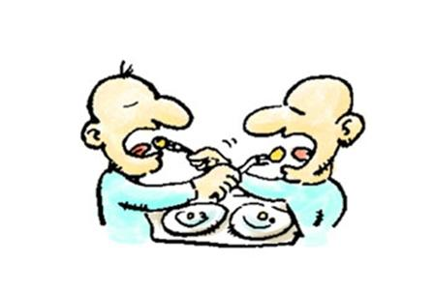
SPARK and Ada
Ada
features
not in SPARK
Additional
SPARK
contracts
not in Ada
Language constructs common to both
SPARK also serves as a testbed for Ada 202x

Slide 13
What Can We Prove, Statically?
Freedom from run-time errors (!!)
No buffer overflow, numeric overflow, divide by zero, invalid array indexes, etc.
Safe to turn off exception checks!
Data and Information flow
No uninitialized variables, no unused assignments, etc.
Data only go where you mean them to go
Functional correctness at unit level
Arbitrary properties, e.g., security and safety

Slide 14
Proving Functional Correctness Example
procedure Push (This : in out Stack; Value : in Content) with
Pre => not Full (This),
Post => not Empty (This)
and Top (This) = Value
and Extent (This) = Extent (This'Old) + 1
and Unchanged (This'Old, Within => This) ,
Global => null,
Depends => (This =>+ Value);
…
function Full (This : Stack) return Boolean;
function Empty (This : Stack) return Boolean;
function Top (This : Stack) return Content with
Pre => not Empty (This);
function Extent (This : Stack) return Content_Count;
function Unchanged (Invariant_Part, Within : Stack) return Boolean;
Verified
Statically
Pass the tests the first time!

Slide 15
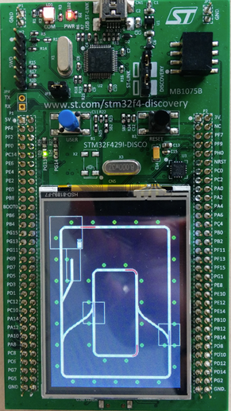
Proving Abstract Properties Example
type Move_Result is (Full_Speed, Slow_Down, Keep_Going, Stop);
procedure Move
(Train : in Train_Id;
New_Position : in Train_Position;
Result : out Move_Result)
with
Pre => Valid_Id (Train) and
Valid_Move (Trains (Train), New_Position) and
At_Most_One_Train_Per_Track and
Safe_Signaling,
Post => At_Most_One_Train_Per_Track and
Safe_Signaling;
function At_Most_One_Train_Per_Track return Boolean;
function Safe_Signaling return Boolean;
…

Slide 16
SPARK Reliability Example
MULTOS is an “operating system” for smartcards
100,000 lines of SPARK code
Industry standard is 5 defects per 1,000 lines
Thus approximately 500 defects expected
Only 4 defects reported 1 year after delivery
0.04 per KSLOC
Corrected under warranty (!)
Ultra-high reliability achieved
Notes:
Page 16

Slide 17
SPARK Productivity Example
Industry standard is 10 lines of code per day
Fully documented, tested, everything
In any language
MULTOS project achieved 28 lines of code per day
Very high levels of productivity achieved
Notes:
Page 17

Slide 18
SPARK C130J Project Results
Order of magnitude code quality improvement over industry norms for DO 178B Level A software
Productivity improved by a factor of 4 over previous comparable programs
Development costs half of that typical for non safety-critical code
Sutton, James: Cost-Effective Approaches to Satisfy Safety-critical Regulatory Requirements. Workshop Session, SIGAda 2000.

Slide 19
Adoption Guidelines Are Available
How to go from a strong semantic coding standard to full functional correctness
Based on the Thales experience
Provides detailed level-specific guidance
https://www.adacore.com/books/implementation-guidance-spark

Slide 20
Takeaway
Ada continues to give more power to the programmer
Use “-gnat2020” switch to play with Ada 202x
SPARK takes Ada a big step further via static verification
Significant productivity and reliability gains are possible
The risks are worth the gains

Slide 21
Questions?

