Slide 2
AdaCore Technologies for Cyber Security
Yannick Moy
November 14th, 2018

Slide 3
Take Home Messages
Use of Ada/SPARK and AdaCore tools helps prevent or mitigate a number of serious security vulnerabilities
Static analysis tools CodePeer and SPARK Pro (GNATprove) can be used to identify around 20 CWE vulnerabilities
AdaCore roadmap includes features and tools to prevent or mitigate security vulnerabilities: fuzz testing, compiler hardening, taint analysis, proven secure libraries

Slide 4
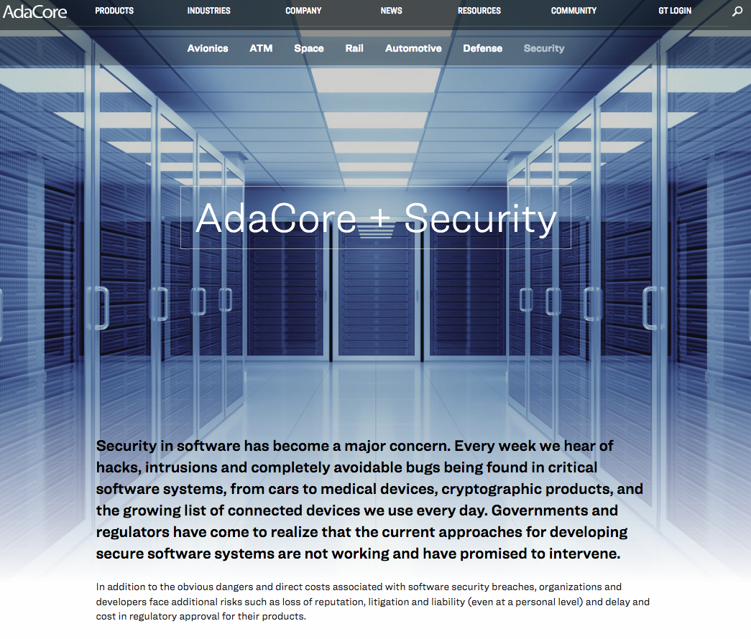

Slide 5
Already 690 books offered!
Already 1016 downloads!

Slide 6
Data Validation – SQL Injection & friends
https://xkcd.com/327/

Slide 7
Data Validation – Mitigations
Dynamic Mitigation
Ada run-time checking
Ada attribute X’Valid
GNAT attribute X’Valid_Scalars
GNAT validity checks -gnatV
Static Mitigation
GNAT warnings
CodePeer static analysis
SPARK Pro proof of checks
SPARK Pro proof of contracts

Slide 9
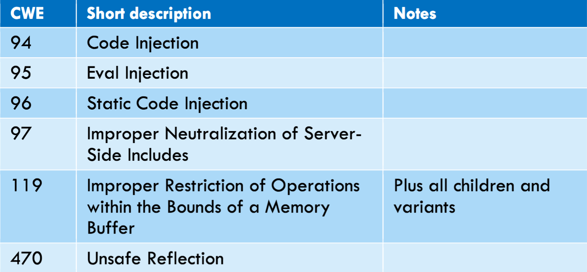
Native Code Injection – Mitigations
Ada Code Injection
No reflection/eval construct
Static linking
Execute from ROM/Flash
Machine Code Injection
Start from buffer overflow
→ Ada run-time checking
→ CodePeer & SPARK Pro

Slide 10
Denial of Service – Mitigations
Dynamic Mitigation
Exception handling
Static Mitigation
Crash proof application?
Loop termination?
→ CodePeer & SPARK Pro

Slide 11
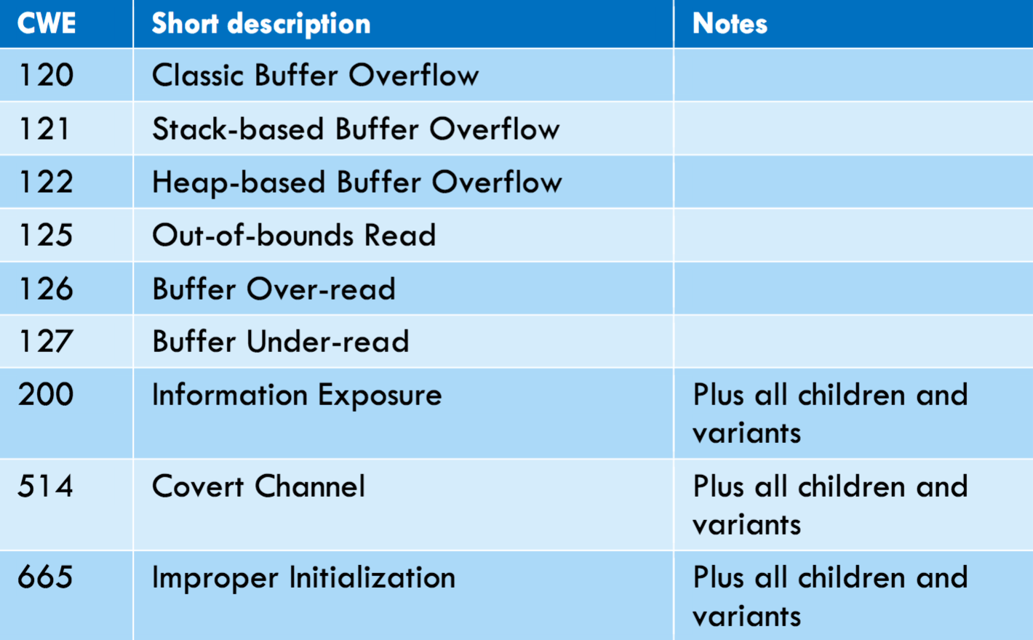
Information Leak – Mitigations

Slide 12
Information Leak – Mitigations

Slide 13
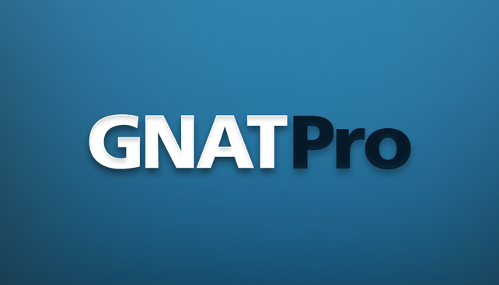
Information Leak – Mitigations
?

Slide 14
Side Channel Attacks
Data Leakage Attacks
- Key material is leaked
- Branch test on secret data
- Array read/write on secret
data
- Verification of secret is time
sensitive
- Secret data is left in memory
Fault Injection Attacks
- Bit-flip Boolean/enums
- Data corruption
- Corrupt return address/PC
- Skip branch decision
- Early loop termination
www.riscure.com/uploads/2017/08/Riscure_Whitepaper_Side_Channel_Patterns.pdf

Slide 15
(Compiler) Hardening
Data Leakage Attacks
- Detect sensitive control flow
- Start array read/write at
random index
- Force verification of secret
to take same time always
- Stack/register erasing
Fault Injection Attacks
- Represent Boolean/enums
on words
- Use data checksums
- Add explicit step counter
- Replicate branch decisions
- Verify loop termination
https://www.embecosm.com/research/secure/

Slide 16
Industrial Scenario Examples
Scenario 1:
Identifying and repairing security vulnerabilities in existing Ada codebases
Scenario 2:
Ada software development practices for increasing security
Scenario 3:
Secure Design
through SPARK
Scenario 4:
Support for Mixed Criticality Systems

Slide 17
Scenario 3 Example: Muen
The Muen Separation Kernel is the world’s first Open Source microkernel that has been formally proven to contain no runtime errors at the source code level.
https://muen.codelabs.ch/

Slide 18
Scenario 3 Example: WooKey
Software classes of attacks (e.g. buffer overflows) are mitigated using EwoK [...] providing more confidence by using the Ada safe language along with SPARK for formal verification of critical parts.
https://github.com/wookey-project

Slide 19
Take Home Messages
Use of Ada/SPARK and AdaCore tools helps prevent or mitigate a number of serious security vulnerabilities
Static analysis tools CodePeer and SPARK Pro (GNATprove) can be used to identify around 20 CWE vulnerabilities
AdaCore roadmap includes features and tools to prevent or mitigate security vulnerabilities: fuzz testing, compiler hardening, taint analysis, proven secure libraries

Slide 20
SPARK Pro Update
Yannick Moy
November 14th, 2018

Slide 21
SPARK Discovery Update
Yannick Moy
November 14th, 2018

Slide 23
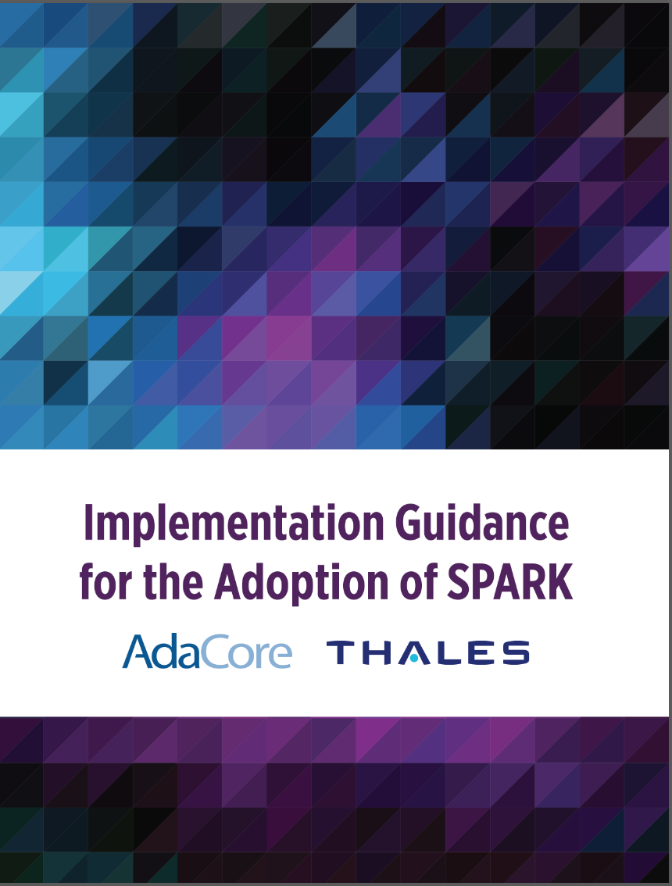
Already 940 books offered!
Already 1119 downloads!

Slide 24
SPARK Pro 19 Content
Program Specification
Tool Automation
Tool Interaction
Tool Usability

Slide 25
SPARK Pro 19 – Program Specification
More precise support for 'Image and 'Img attributes
Support for more fixed-point types and operations
New SPARK-compatible libraries for dimensional analysis
New lemmas for exponentiation, fixed-point arithmetic and higher-order functions [only SPARK Pro]

Slide 26
SPARK Pro 19 – Tool Automation
Automatic detection of array initialization with non-static bounds
Automatic unrolling of loops with dynamic bounds or executed only once
Improved support for floating-point computations [only SPARK Pro]

Slide 27
SPARK Pro 19 – Tool Interaction
Better messages:
- to understand root cause for SPARK violations
- to investigate unproved checks
- to detect inconsistencies
Better counterexamples: [only SPARK Pro]
- on values of private types and float types
- on individual paths through subprograms
Better integration in GPS:
- path for missing dependency can be displayed
- ability to focus analysis on region of code
- new Analysis Report panel

Slide 28
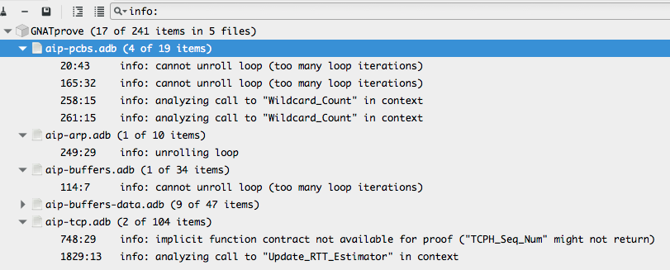
Better messages – Info Messages
Enabled by switch --info

Slide 29
Better messages – Possible Explanation

Slide 30
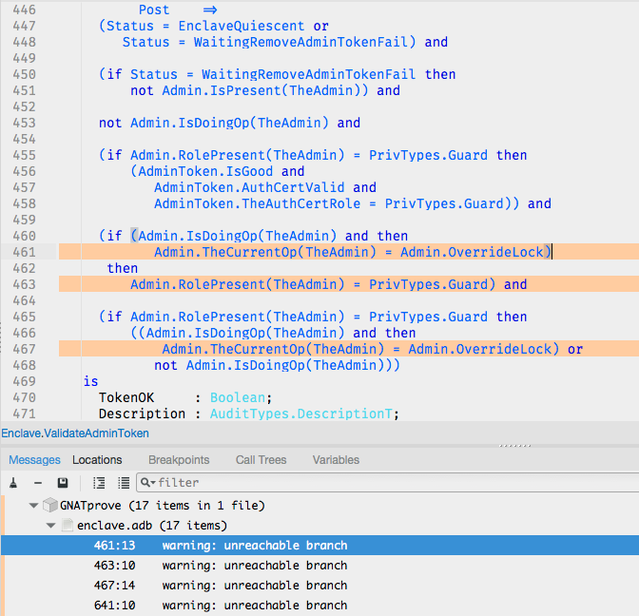
Better messages – Warnings by Proof
Enabled by switch
--proof-warnings
Warn on:
- precondition or
postcondition
always False
- dead code after loop
- unreachable branches
in assertions

Slide 31
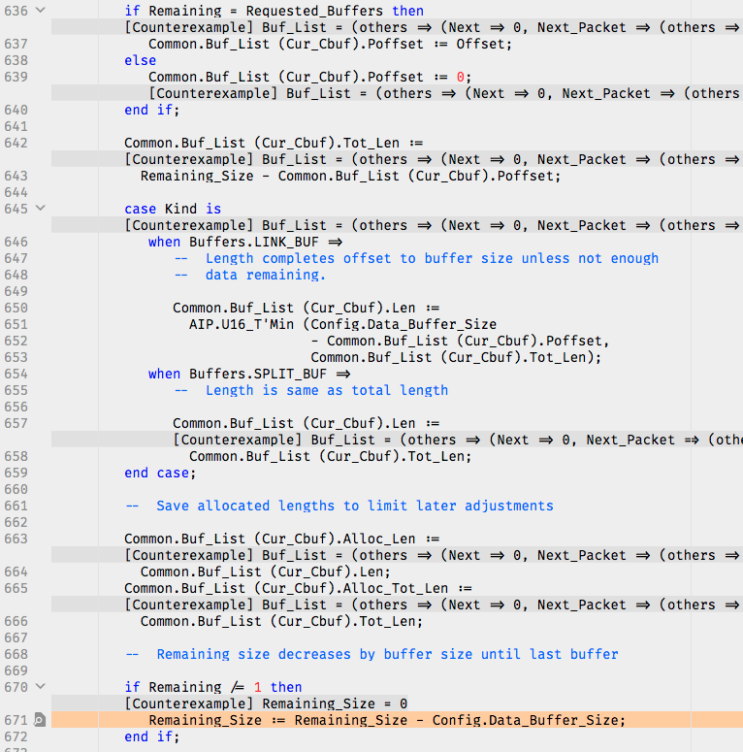
Better counterexamples – Single Path

Slide 32
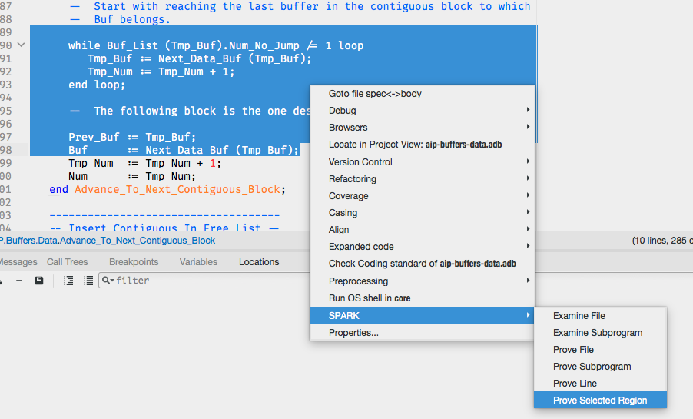
Better GPS Integration – Analyze Region

Slide 33
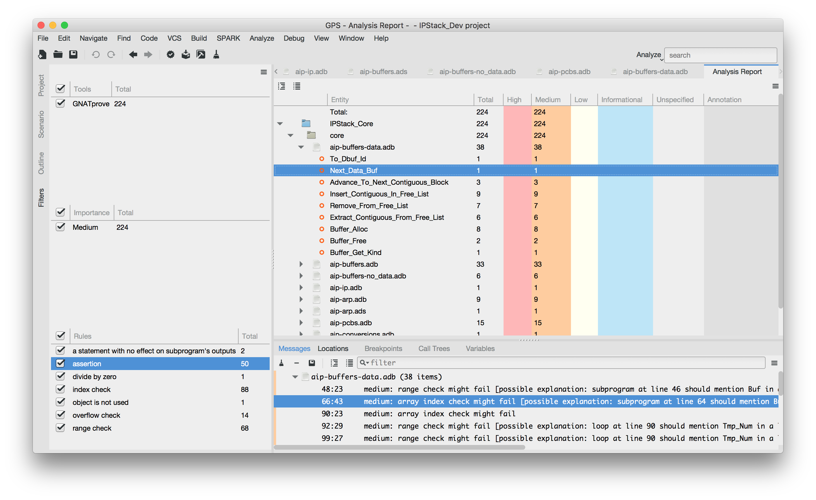
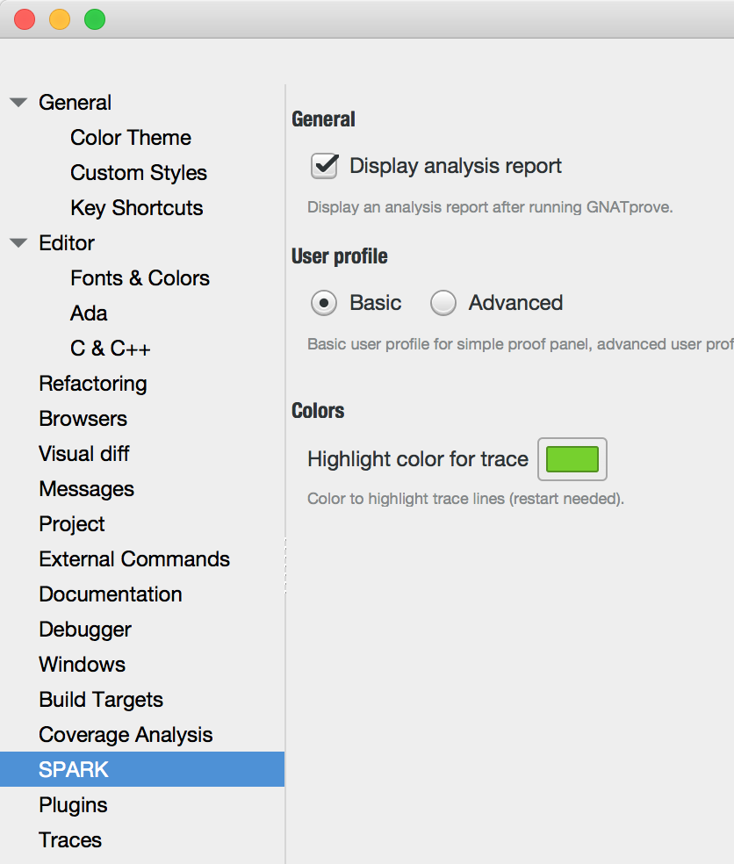
Better GPS Integration – Analysis Report

Slide 34
SPARK Pro 19 – Tool Usability
New switches
- to limit memory used by provers
- to treat failed checks as errors
- to support --subdirs and --no-subprojects
Better predictability of running time with --level switch
Speedup on large projects

Slide 35
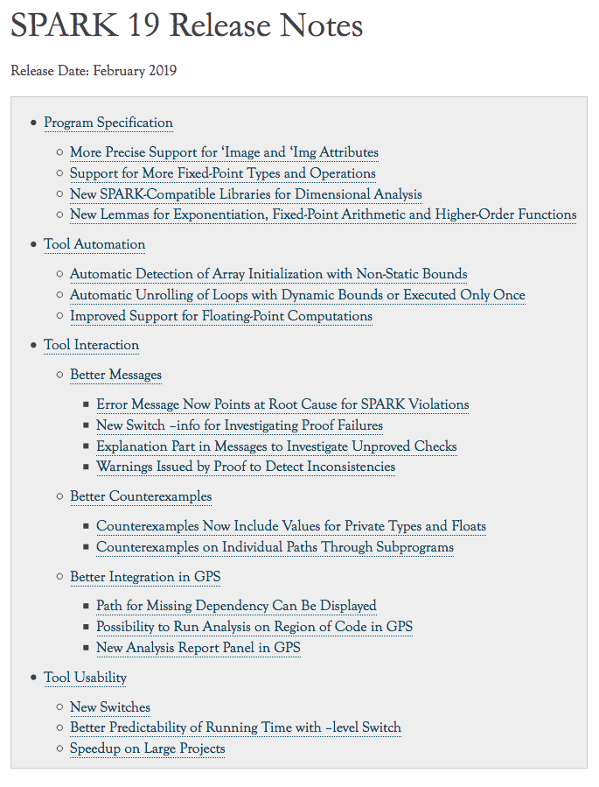
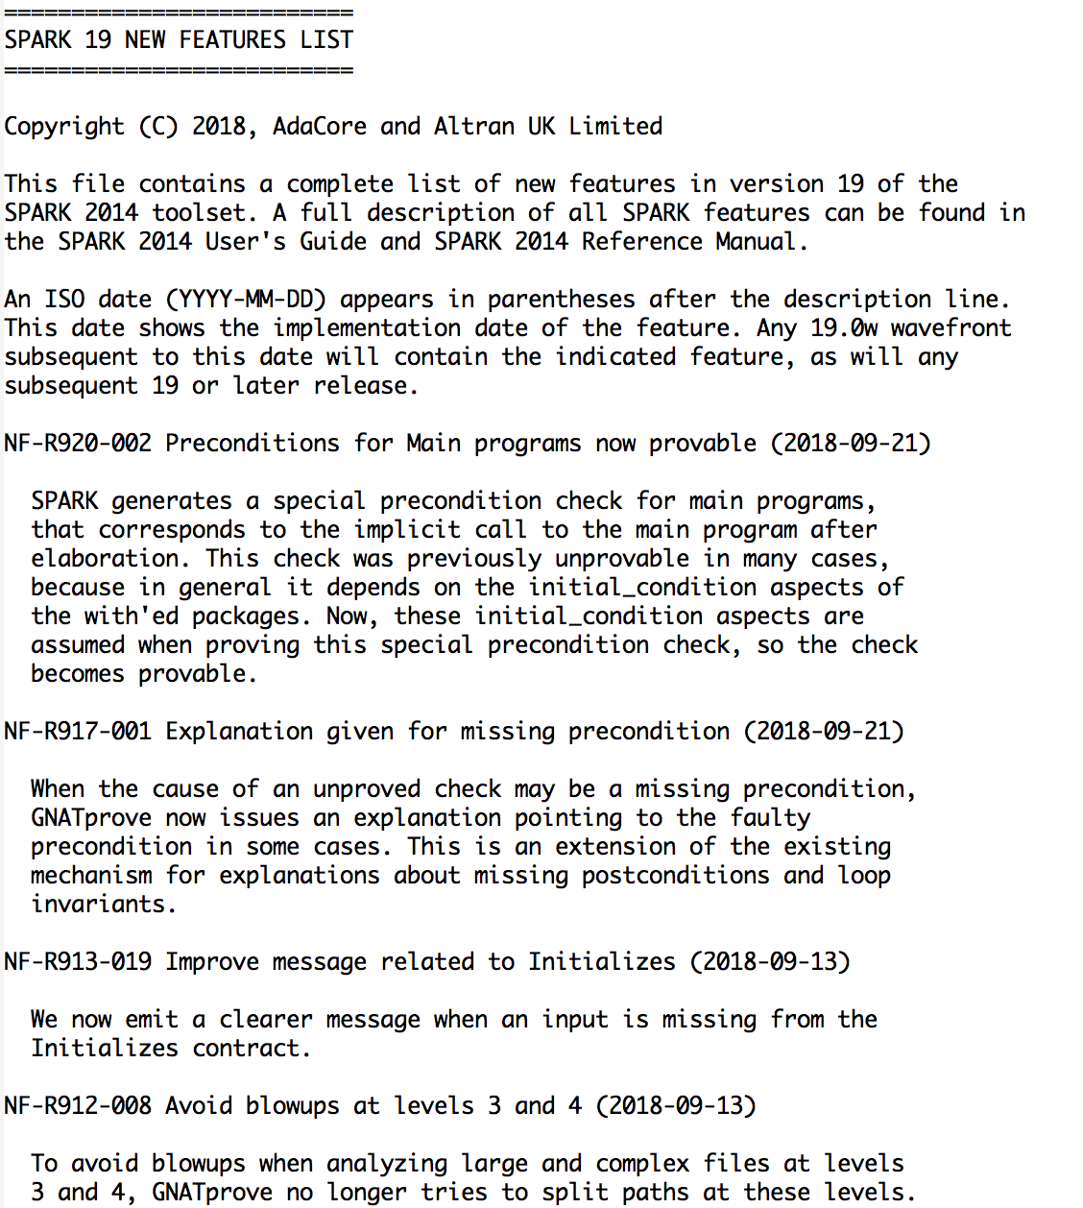

Slide 36
SPARK Pro 20 – Roadmap
Support for safe Rust-like ownership pointers
Improved support for floating-point computations
Better interactions: messages, counterexamples, GPS integration…
Contracts on standard libraries and bindings to other libraries
Proven libraries and lemma libraries

