Slide 2
Adapting GPS to your Workflows
Nicolas Setton
2018-11-14

Slide 3
Workflows...
Defined by procedure
Defined by VCS
Defined by the environment
☑︎ Step 1 ---
☑︎ Step 2 ---
☒ Step 3 ---
☐ Step 4 ---
.git
fork
pull
request
clone
review

Slide 4
Some examples
AdaCore (on GPS project: 440k SLOC)
Workstations
- IDE
- build
- debug
- IDE
- build
- debug
IDE
build
debug
IDE
build
debug
*optional*
interactive servers

Slide 5
Some examples
AdaCore Customer X
(project size: around 1M SLOC)
view
view
Thin clients
view
Remote Desktop software
IDE
build
debug
Shared server

Slide 6
Some examples
AdaCore Customer Y
(project: around 4 million SLOC)
Workstations
- IDE
- debug
- IDE
- debug
TWO HUNDRED CORE
DISTRIBUTED GPRBUILD FARM
build
build
build

Slide 7
Some design principles in GNAT Pro
GPS should never get in the way of workflows
GPS should be flexible to adapt to any workflow
Most of the features are available in command-line
No proprietary format for storing information

Slide 8
3 FAQs, tips & tricks

Slide 9
FAQ#1 Using GPS remotely
GPS Remote is an option
GPS over X11 works very well

Slide 10
Tip#1 Use a minimal project for using GPS
You can write a (very) simplified .gpr just for the needs of GPS …
… And build with your own build scripts.

Slide 11
Tip#2 Build with your own build scripts
You can write a (very) simplified .gpr just for the needs of GPS …
… And build with your own build scripts.

Slide 12
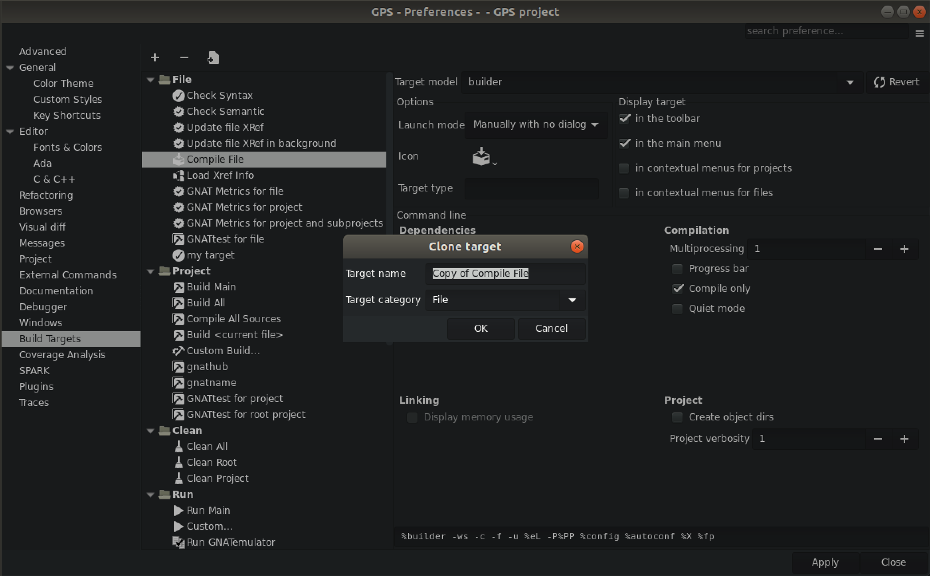
Preferences dialog →
Click here
to “clone”
an existing Target

Slide 13
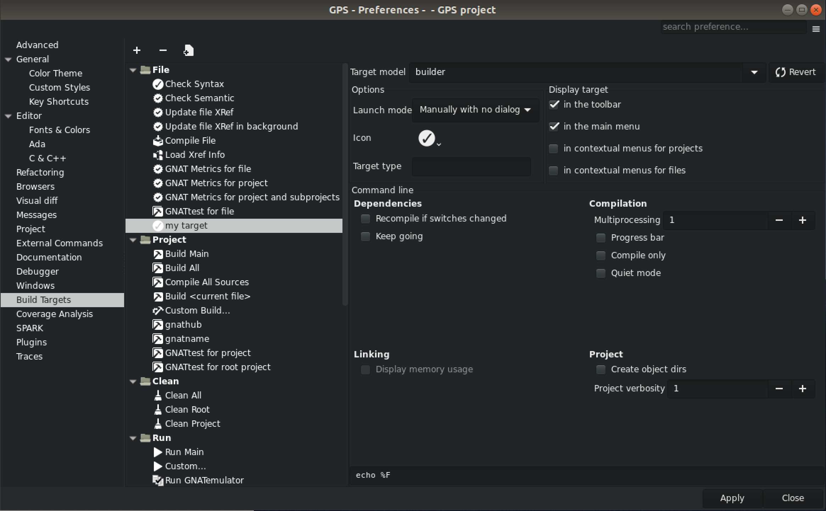
Here to select an icon
Here to select whether this goes in the menu / the toolbar
The command line for your script

Slide 14
Tip #2 Build with your own build scripts
To get a progress bar, your script can emit completed X out of Y (Z%)...
(also: hidden ‘-d’ switch of gprbuild)
You can share the build target definition with the team.

Slide 15
Tip #3 place the cross-references database on a fast disk
package IDE is for Xref_Database use "xref_database.db"; -- This would be /home/user1/work/xref_database.db for Xref_Database use Project'Object_Dir & "/xref_database.db"; -- This would be /home/user1/work/obj/xref_database.db -- This is the default when this attribute is not specified for Xref_Database use external("HOME") & "/prj1/database.db"; -- This would be /home/user1/prj1/database.db end IDE;

Slide 16
Things that are very easy to do using GPS customization
Associate key shortcuts to any action
Create menus and buttons for launching your tools
Make some files read-only
Change the background colors of editors
Display welcome messages / help messages
Provide basic dialogs

Slide 17
Advanced GPS customization
Provide full views
Libadalang tools
Customized VCS

Slide 18
FAQ#2 Sharing plugins / customization
.gps/plug-ins ← personal plugins
<project_name>.ide.py ← per-project plugins
$GPS_CUSTOM_PATH ← team plugins
<gps_install>\share\gps\plug-ins ← team plugins

Slide 19
FAQ#3 GPS should be fast
On my Linux virtual machine, on a 440k SLOC project
3 seconds to launch
12 seconds to index the entire project
around 1 second to open a large editor
Please report if this is not the case for you

Slide 20
Your best tool for adapting GPS to your workflow
AdaCore customer support

