Slide 1
Market perspective - what’s new and where are we heading?
Jamie Ayre
Wednesday November 14th, Boston

Slide 2
It’s all about you
This event is your event!

Slide 3
Please pester the AdaCore staff!
We’re here to answer your questions, discuss roadmaps, don’t leave with any un-asked questions!

Slide 4
Technical team is well represented!
GNAT Pro, GPS, SPARK, CodePeer, Coverage, QGen, Libadalang, Cybersecurity, ...

Slide 5
Goodies!
Help yourself to all the collateral available (we don’t want to take it home!)

Slide 6
Focusing our strategy
Deepening our technical offer for our existing customers whilst promoting Ada to new markets.

Slide 7
Focusing our strategy
But what does that really mean? How does that translate?

Slide 8
Products for the discerning developer
GNAT Pro Assurance
C++
Services

Slide 9
GNAT Pro Assurance
Enterprise
Assurance (on 18)
18.4
18.5
18.3
18.2
18.1
18.0
18.0w
19.0w
2017
2018
2019
GNAT Pro Enterprise + a Sustain Branch
(Critical Fixes, Critical Problems Analysis)

Slide 10
Ada/C/C++ - GNAT supports them all
C++ - native platforms: Linux and Windows
C++ - support for Embedded Linux & RTOS platforms coming in 2019
Assurance available for all languages and platforms
Let us know what your plans and needs are!

Slide 11
Services for the discerning developer
Getting the most out of AdaCore tools
Getting the most out of AdaCore technical expertise
Adopting and adapting the products to your environment

Slide 12
Beefing our RTOS support
VxWorks 6, 7 & 653 support
ARM
PowerPC
Intel
64 & 32 bit
C++ 2019

Slide 13
Beefing our RTOS support
LynxOS-178 2.2.4
x86
PPC
LynxOS Separation Kernel on Intel

Slide 14
We can’t do it all...
Rapita
Vector
RTI
Verocel
Lauterbach
...

Slide 15
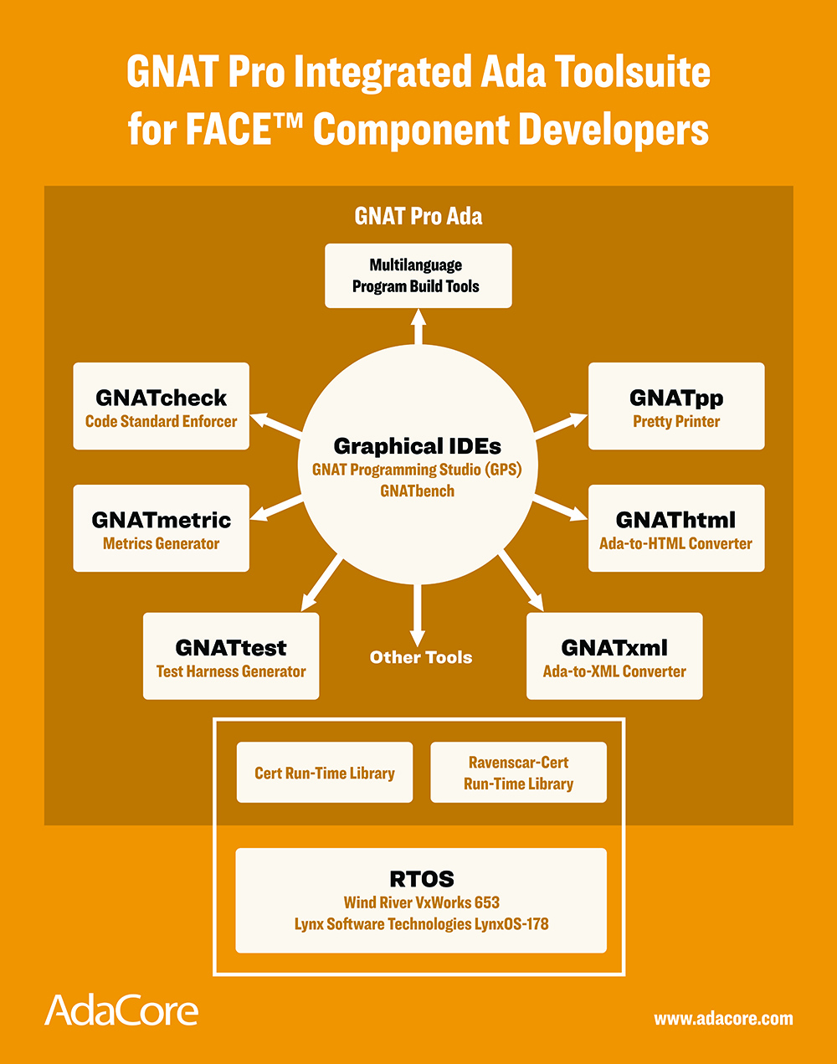
FACE what is that?

Slide 16
Focusing our strategy
Promoting Ada as a modern language to new markets...

Slide 17
Teach software engineering, not coding...
Thanks to our Academic partners here today

Slide 18
Cybersecurity what does it mean?

Slide 19
Cybersecurity — How can Ada help?

Slide 20
Ada is economical

Slide 21
So who’s convinced?

Slide 22
Resources to help you code

Slide 23
Going Green Newsletter paper or electronic?

Slide 24
Focusing our strategy
Ada continues to be our focus, exceptional customer support is our business.

Slide 25
Focusing our strategy
Please continue to help us grow

