Slide 2
QGen and TQL Qualification
Jose Ruiz
Thursday October 4, 2018

Slide 3
Index
Two words about QGen
Qualification benefits
Qualification activities
Roadmap

Slide 4
What is QGen
Trusted Code Generator
From Simulink® & Stateflow® to SPARK Ada / MISRA C
Customizable code generation
Aiming for DO-178C at Tool Qualification Level 1
Consistency of the generated code and the Simulink® simulation
Model Verifier
Formal static model verifier for runtime errors and functional properties
Aiming for DO-178C at Tool Qualification Level 5
Integrated Model-Based Development Toolset
Model-level debugger
Processor-In-the-Loop testing
Coverage analysis

Slide 5
Why a Qualified Code Generator
Certification is expensive!
Source code reviews and verifications
Low-Level Requirements (LLR)-based testing
Coverage analysis (MC/DC)
QGen Qualification at TQL-1 can greatly reduce that cost
LLR expressed as Model
TQL-1 QGen
Generated Source Code

Slide 6
The Qualification Advantage
Bypass reviewing the generated source code
QGen TQL-1 guarantees: compliance with requirements & standards, and traceability between model and generated code
Bypass LLR-based testing of the generated source code
Conformance to Simulink semantics guaranteed by QGen TQL-1
High-Level Requirements (HLR) simulation cases can be re-run on target to validate the compiler
Bypass coverage analysis of generated source code
Model-level coverage + QGen TQL-1 guarantee code-level coverage

Slide 7
What We are Doing for Qualification
Together with partner Verocel
Working very closely with FAA and QGen TQL-1 launch customers
Qualification artifacts
Documentation
Risk-based analysis
Requirements
Test cases and procedures
Coverage analysis

Slide 8
Risk-Based Analysis
Hazard analysis
Identification and satisfaction of safety requirements
Include risks from development methods and tools, such as
Dynamic memory
Uninitialized variables
Code complexity
Assurance Case
Structured argument presenting evidences with rationale

Slide 9
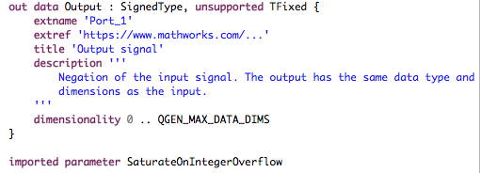
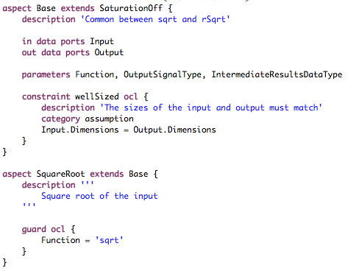
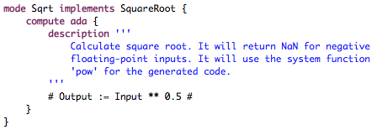
Requirement Definition
Description
Use of formal language to define operational semantics
Set of blocks supported
Types
Configurations
Parameter values
Behavior
...
Structure
Configuration
Implementation

Slide 10
Tests: Show Correctness
Ensure behavioral equivalence
Model simulation is our oracle
Ensure structural equivalence
Manual review of generated source code (representative subset)
Check compliance against requirements
Check structural equivalence between source model and generated code
Comparison of model coverage and code coverage

Slide 11
Tests: Show Completeness
Use formal semantic definition
Identify supported configurations
Nominal and robustness
Identify equivalence classes for tests
End-to-end testing, based on tool external interface
Input: model
Output: generated code and behavior (model and code)

Slide 12
2018: Code Generation
A lot around qualification
SOI#1 material (planning and supporting tools)
Faster code generation with stable output
Incremental model export
Modular code generation
Enhanced Simulink support
Extract Bits, String support, Unit Conversion
Additional block configurations and MATLAB functions

Slide 13
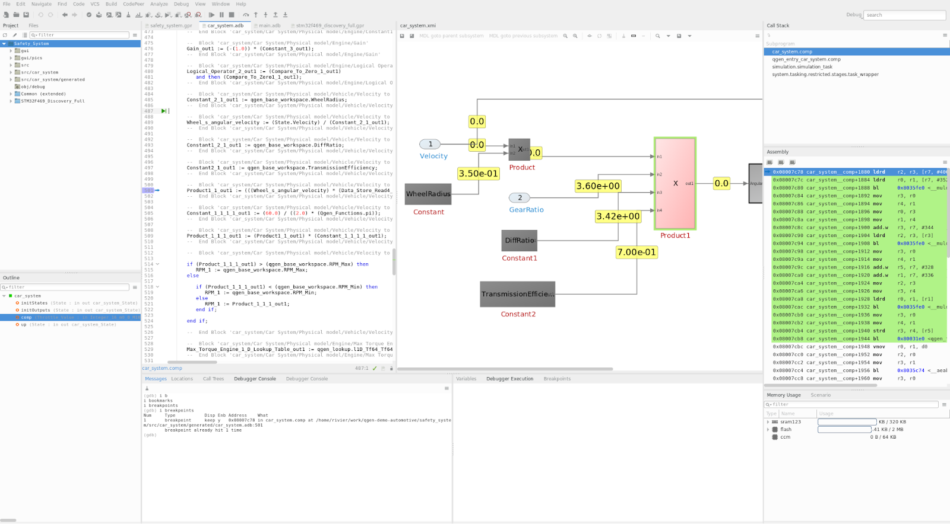
2018: Model-Based Toolset
Enhanced QGen Verifier messages and User Interface
Enhanced QGen Model Debugger

Slide 14
2019-2020: Code Generation
QGen TQL-1 Qualification Kit
Support for new Simulink versions: 2019a/b, 2020a/b
Impact analysis for Simulink version upgrade
Enhanced integration and debugging of S-Functions (Ada and C)
Support fixed-point data types
Support of Data Dictionary

Slide 15
2019-2020: Model-Based Toolset
Support Stateflow within the QGen Debugger
Tool Support for System-to-Software Integrity
Support architectural specifications and requirements
Generate SPARK contracts to find requirement violations
Enhancements for Automotive Domain
AutoSAR, TargetLink

Slide 16
Notes:
Tools (code generator, verifier, model debugger) got a very nice maturity level
Good progress on the work around infrastructure and tooling for qualification

