Slide 2
Technology Adoption Services
Michelle Ricardo
October 4, 2018

Slide 3
Did You Know AdaCore Offers Services?
Consulting
Training
Development
Notes:
Consulting: Support high priority projects & Provide specialized expertise
Training: Demonstrate that the Ada language is learnable & Help AdaCore developers get the most out of AdaCore technology (public training, and onsite more customizable training)
Custom Development: Ensure Ada is available on platforms and in all contexts needed

Slide 4
Why Services?
1. Because services are core to our mission.

Slide 5
Why Services?
2. Because industry requests services.
Teams Seeking to Adopt AdaCore Technology in Complex Environments:
Military and non-military
Ada experts and novices
Current users of some AdaCore tools and others endeavoring to use them for the first time

Slide 6
Complex Technology Adoption Goals
Migrating to SPARK or Ada from other languages
Building a prototype application using SPARK or Ada
Migrating to GNAT Pro from other Ada compilers
Integrating AdaCore tools into engineering process
Integrating CodePeer into development process
Notes:
Teams invest time and resources to adopt our tools AND providing services that ease the complex and often difficult process of developing high integrity software is our mission

Slide 7
New Technology Adoption Service?
Mentorship

Slide 8
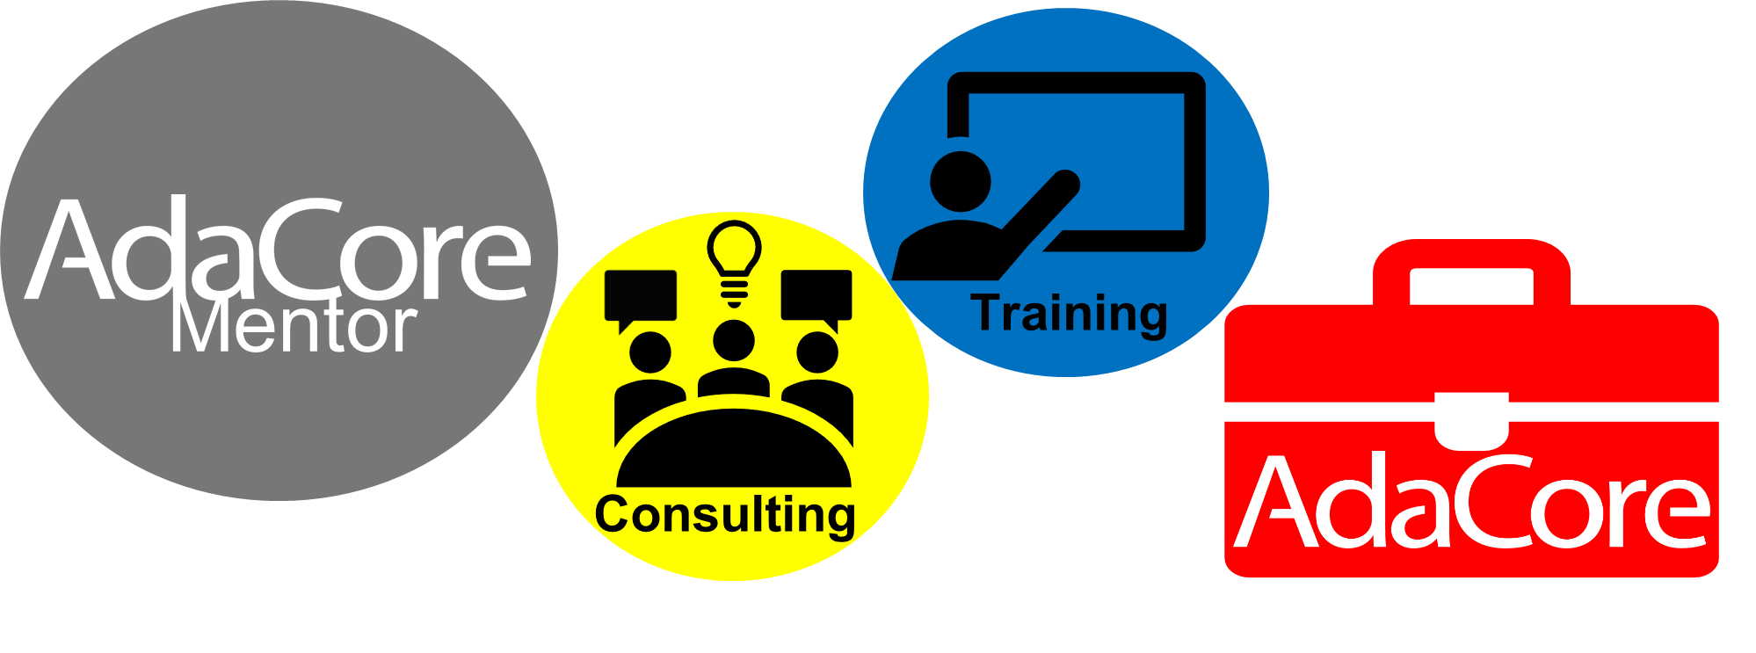
What is AdaCore Mentorship?
Notes:
customized services and tools bundled with premium support
Training
Consulting (visits, calls, coding assistance)
Access to all relevant AdaCore tools
Expert technical support
Dedicated mentor
Defined goals and time period defined at the outset.

Slide 9
AdaCore Mentorships
Automotive
Military Drones
Railway
Security
Silicon

Slide 10
Mentorship Railway Case Study – “C2 Corp”
C2 Corp’s Technology Adoption Goal
Build protype application using SPARK/Ada for an existing C application within 4 months Team: very little Ada and formal methods experience
Notes:
Tools: GNAT Pro Ada & C, SPARK Pro, GNATcoverage Platforms: PPC Linux 32 bits, Windows 32 & 64 bits, Linux 32 & 64 bits

Slide 11
Mentorship Railway Case Study – “C2 Corp”
C2’s AdaCore Mentor:
Identified relevant tools and experts
Coordinated on-site visits
Hosted regular technical calls
Coordinated coding assistance
Tracked all technical tickets
Mentor
Notes:
Acted as C2’s AdaCore liaison

Slide 12
Mentorship Railway Case Study – “C2 Corp”
Consulting
Training
Two 1-day visits
Two 2-day visits
Weekly technical calls
Coding assistance
5-day SPARK/Ada
3-day SPARK
GNAT Pro Ada & C
SPARK Pro
GNATcoverage
Natives and Cross Platforms

Slide 13
C2 Corp Mentorship Conclusion
Successful SPARK/Ada prototype built after 6 months
Identified and selected tools needed
Identified development team
Working toward railway certification

Slide 14
New Technology Adoption Service
Mentorship
Helping People Build Software that Matters

Slide 15
Technology Adoption Services
Michelle Ricardo Ricardo@AdaCore.com

