Slide 2
CodePeer Update
Arnaud Charlet
2018-10-04

Slide 3
What is Static Analysis?
Basic Static Analysis: coding standard checking, metrics, compiler warnings and style checks
Advanced Static Analysis: symbolic execution/interpretation of source code, whole program analysis to perform software analysis
Formal Verification: verify high level or abstract properties of your application, give strong guarantees

Slide 4
Why Use Static Analysis?
Make software more reliable at reasonable cost
Full coverage of your code
No missing check (no “false negatives”)
Anticipate problems (get results before testing)
Automate part of code review
Express and verify your requirements and architecture

Slide 5
CodePeer Overview
Advanced static analysis tool for Ada
Includes also basic static analysis (gnatcheck, gnatmetric)
Detects runtime and logic errors
Buffer overflow, division by zero, dead code, …
Analyzes complete or partial programs (full Ada)
Generates human readable annotations
CWE compatible (http://cwe.mitre.org)

Slide 6
What’s New in CodePeer 19

Slide 7
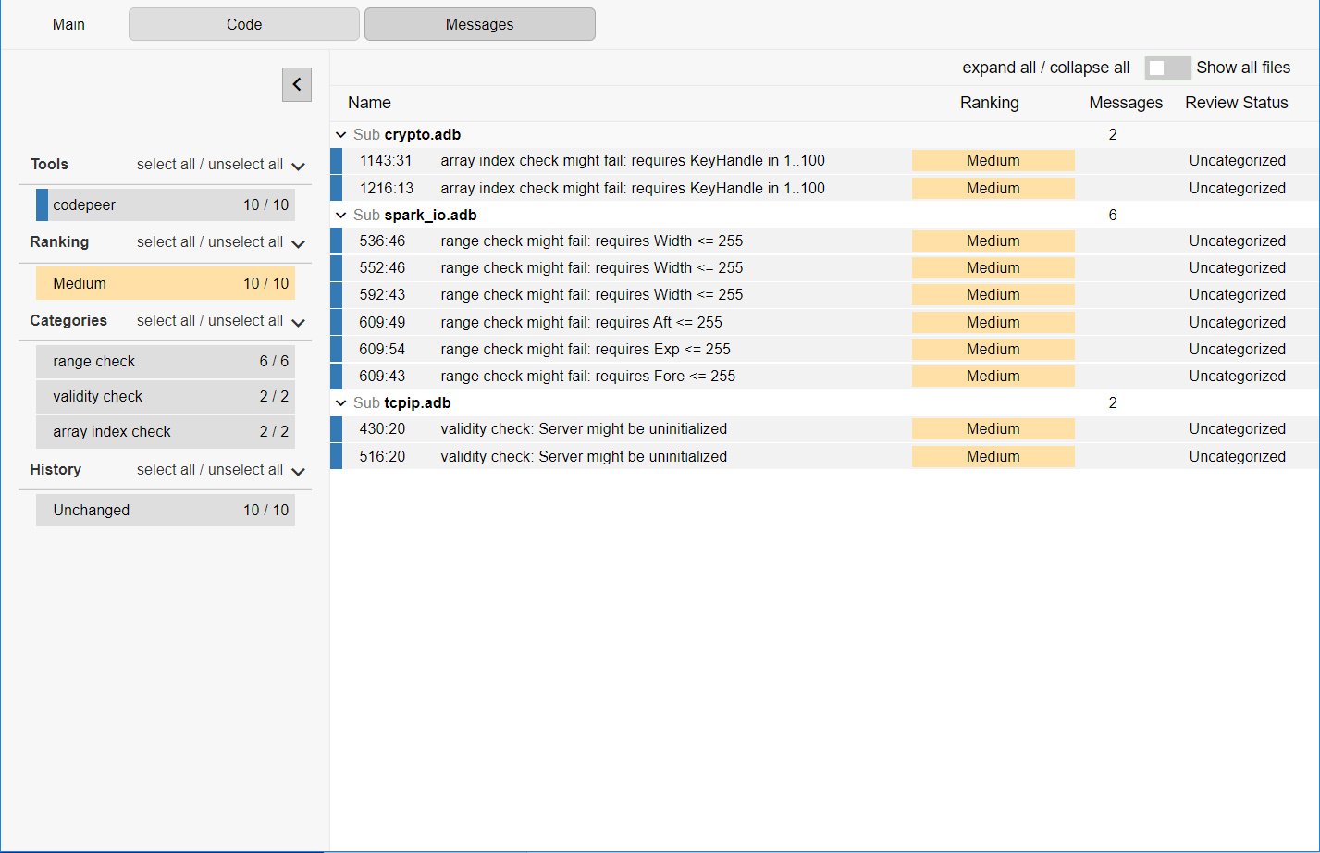
New Web Interface

Slide 8
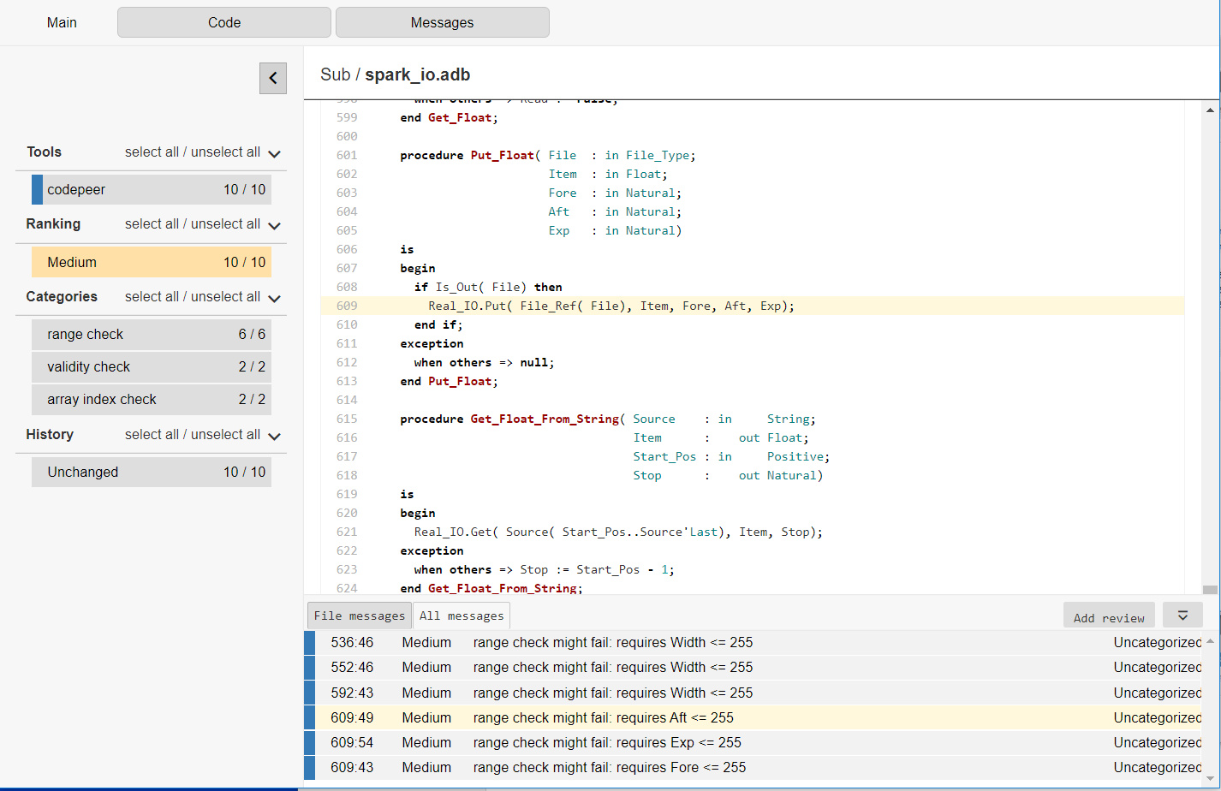
New Web Interface

Slide 9
New Entry Level
Level 0 with “lal” checkers
New default
Very few false positives
Very fast analysis
Will allow users to write their own checkers in the future

Slide 10
Simple Project Set Up
Available at level 0 via the --simple-project switch
Only source directories need to be specified
No need to specify any naming scheme

Slide 11
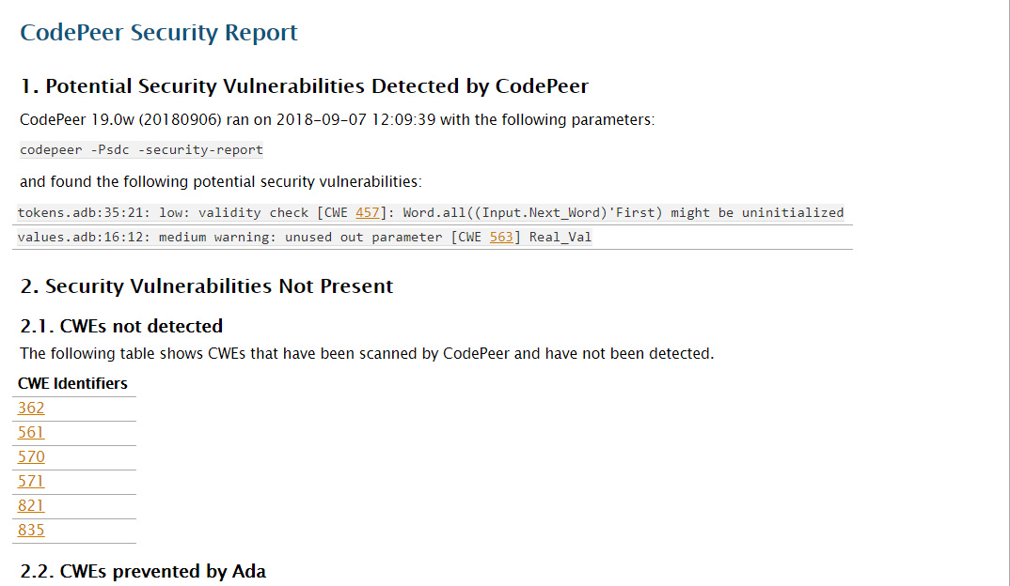
Security Report

Slide 12
Major Documentation Updates
Reorganization
Many user workflows documented
Analyzing code locally prior to commit
Nightly runs on a server
Continuous runs on a server after each change
Combined desktop/nightly run
Combined continuous/nightly run
Combined desktop/continuous/nightly run
Software customization per project
Compare local changes with master
Multiple teams analyzing multiple subsystems
Use CodePeer to generate a security report

Slide 13
GNATcheck integration
Coding standard checker
Can be launched automatically by CodePeer
Results are integrated in the database
Displayed in GPS, HTML, ...

Slide 14
GPS Client/Server
Access CodePeer results remotely
Perform manual review of messages remotely

Slide 15
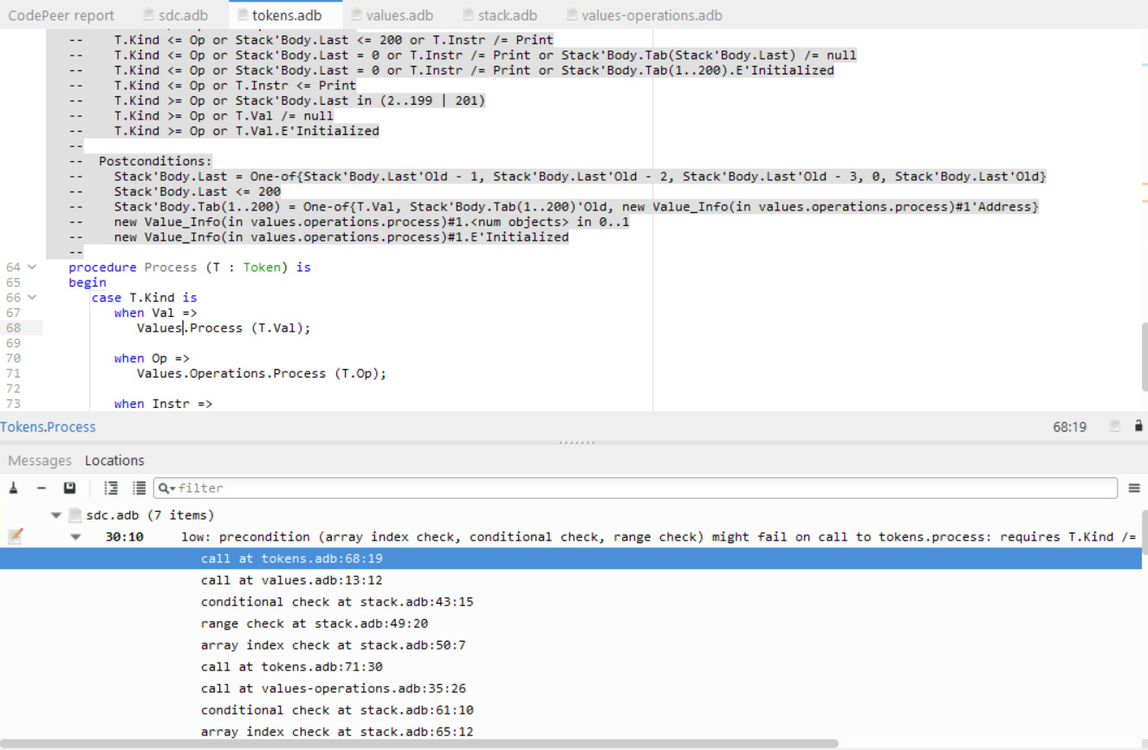
Improved display of backtraces

Slide 16
Detailed Timing Info
analyzed admin.scil in 1.21 seconds
analyzed msgproc__body.scil in 0.09 seconds
analyzed msgproc.scil in 0.00 seconds
analyzed cryptotypes.scil in 6.02 seconds

Slide 17
Other Features (1/2)
Ability to show only new messages
Ability to compare any two runs
Filter messages via switches

Slide 18
Other Features (2/2)
Reproducible successive runs
Performing reviews via a CSV file
Improved precision and analysis time

Slide 19
CodePeer Mentorship

Slide 21
Peer Reviews
Contracts can be used in place of (some) information documentation
GNAT Doc (will) include contracts in generated documentation

Slide 22
Peer Reviews
Contracts can be used in place of (some) information documentation
GNAT Doc (will) include contracts in generated documentation
Contracts review can be included as part of certification-related reviews
Contracts review can be included as part of certification-related reviews

