Slide 2
General Programming on Graphical Processing Units
Quentin Ochem
October 4th, 2018

Slide 3
What is GPGPU?
GPU were traditionally dedicated to graphical rendering …
… but their capability is really vectorized computation
Enters General Programming GPU (GPGPU)

Slide 4
GPGPU Programming Paradigm
Debug?
Optimize data transfer?
core | core | core
core | core | core
core | core | core
Offload computations
Refactor parallel algorithms?
Avoid data races?
How to optimize occupancy

Slide 5
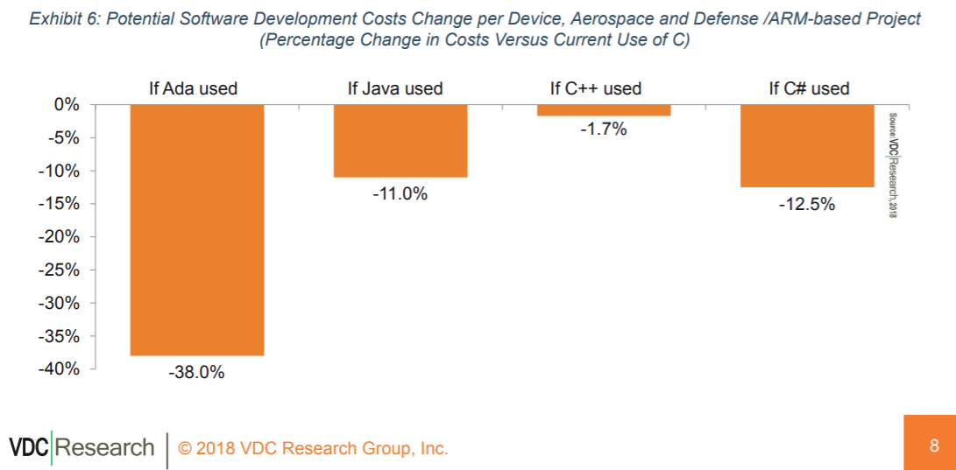
Why do we care about Ada? (1/2)
Source: https://www.adacore.com/uploads/techPapers/Controlling-Costs-with-Software-Language-Choice-AdaCore-VDC-WP.PDF

Slide 6
Why do we care about Ada (2/2)
Signal processing
Machine learning
Monte-carlo simulation
Trajectory prediction
Cryptography
Image processing
Physical simulation
… and much more!

Slide 7
Available Hardware
Desktop & Server
Embedded
NVIDIA Tegra ARM Mali Qualcomm Adreno IMG Power VR Freescale Vivante
NVIDIA GeForce / Tesla / Quadro
AMD Radeon
Intel HD

Slide 8
Ada Support

Slide 9
Three options
Interfacing with existing libraries
“Ada-ing” existing languages
Ada 2020

Slide 10
Interfacing existing libraries
Already possible and straightforward effort
“gcc –fdump-ada-specs” will provide a first binding of C to Ada
We could provide “thick” bindings to e.g. Ada.Numerics matrix operations

Slide 11
“Ada-ing” existing languages
CUDA – kernel-based language specific to NVIDIA
OpenCL – portable version of CUDA
OpenACC – integrated language marking parallel loops

Slide 12
CUDA Example (Device code)
procedure Test_Cuda
(A : out Float_Array; B, C : Float_Array)
with Export => True, Convention => C;
pragma CUDA_Kernel (Test_Cuda);
procedure Test_Cuda
(A : Float_Array; B, C : Float_Array)
is
begin
A (CUDA_Get_Thread_X) := B (CUDA_Get_Thread_X) + C (CUDA_Get_Thread_X);
end Test_cuda;

Slide 13
CUDA Example (Host code)
A, B, C : Float_Array;
begin
-- initialization of B and C
-- CUDA specific setup
pragma CUDA_Kernel_Call (Grid’(1, 1, 1), Block’(8, 8, 8));
My_Kernel (A, B, C);
-- usage of A

Slide 14
OpenCL example
Similar to CUDA in principle
Requires more code on the host code (no call conventions)

Slide 15
OpenACC example (Device & Host)
procedure Test_OpenACC is
A, B, C : Float_Array;
begin
-- initialization of B and C
for I in A’Range loop
pragma Acc_Parallel;
A (I) := B (I) + C (I);
end loop;
end Test_OpenACC;

Slide 16
Ada 2020
procedure Test_Ada2020 is
A, B, C : Float_Array;
begin
-- initialization of B and C
parallel for I in A’Range loop
A (I) := B (I) + C (I);
end loop;
end Test_Ada2020;

Slide 17
Lots of other language considerations
Identification of memory layout (per thread, per block, global)
Thread allocation specification
Reduction (ability to aggregate results through operators e.g. sum or concatenation)
Containers
Mutual exclusion
…

Slide 18
A word on SPARK
X_Size : 1000;
Y_Size : 10;
Data : array (1 .. X_Size * Y_Size) of Integer;
begin
for X in 1 .. X_Size loop
for Y in 1 .. Y_Size loop
Data (X + Y_Size * Y) := Compute (X, Y);
end loop;
end loop;
{X = 100, Y = 1}, X + Y * Y_Size = 100 + 10 = 110
{X = 10, Y = 10}, X + Y * Y_Size = 10 + 100 = 110

Slide 19
Next Steps
AdaCore spent 1 year to run various studies and experiments
Finalizing an OpenACC proof of concept on GCC
About to start an OpenCL proof of concept on CCG
If you want to give us feedback or register to try technology, contact us on info@adacore.com

