Slide 1


Slide 2

GNAT Pro Update
Arnaud Charlet
2018-10-04

Slide 3
Release Schedule
October: Preview release Oct 2018: 19.0 Continuous Release Area
February: Major release Feb 2019: 19.1
July: Corrective release July 2019: 19.2
Oct 2019: 20.0 Continuous Release Area
Feb 2020: 20.1
July 2020: 20.2

Slide 4
Continuous Release Area
A new download area in GNAT Tracker
Acts as a way to continuously provide previews of our products
Regularly updated during the year

Slide 5
GNAT

Slide 6
GNAT Pro 19 overview
62 platforms (57 cross, 5 native)
Support for Ada 83, 95, 2005, 2012, 202x, SPARK
GCC 6.x ➠ GCC 7.x
Binutils: 2.28.51 ➠ 2.30.52
GDB 7.10 ➠ GDB 8.2
MinGW 3.1.0 ➠ 5.0
QEMU 2.8.1 ➠ 3.0

Slide 7
GNAT Pro Ports
7 new ports, 11 new configurations
riscv64-elf
aarch64-elf-{linux,windows}64
aarch64-linux-linux64
aarch64-qnx-{linux,windows}64
aarch64-vx7-{linux,windows}64
ppc-linux-windows
x86-lynx178elf-{linux,windows}64

Slide 8
GNAT on VxWorks
Simplify mixing Ada/C++
Better integration of GNAT in Workbench (even for Ada-only projects)
Add support for Wind River's LLVM

Slide 9
Libadalang integration
Libadalang available to customers and supported
GNATpp now based on libadalang
faster and doesn’t require closure, support for simple preprocessor
directives
More to come

Slide 10
Other GNAT Highlights
Spectre V2 mitigation (-mindirect-branch and -mfunction-return switches)
Link time speedup on Windows for large executables with multiple DLLs
Full Ada 2012 syntax for C/C++ binding produced by -fdump-ada-spec
Improved suppression of access-before-elaboration checks and warnings

Slide 11
IDEs

Slide 12
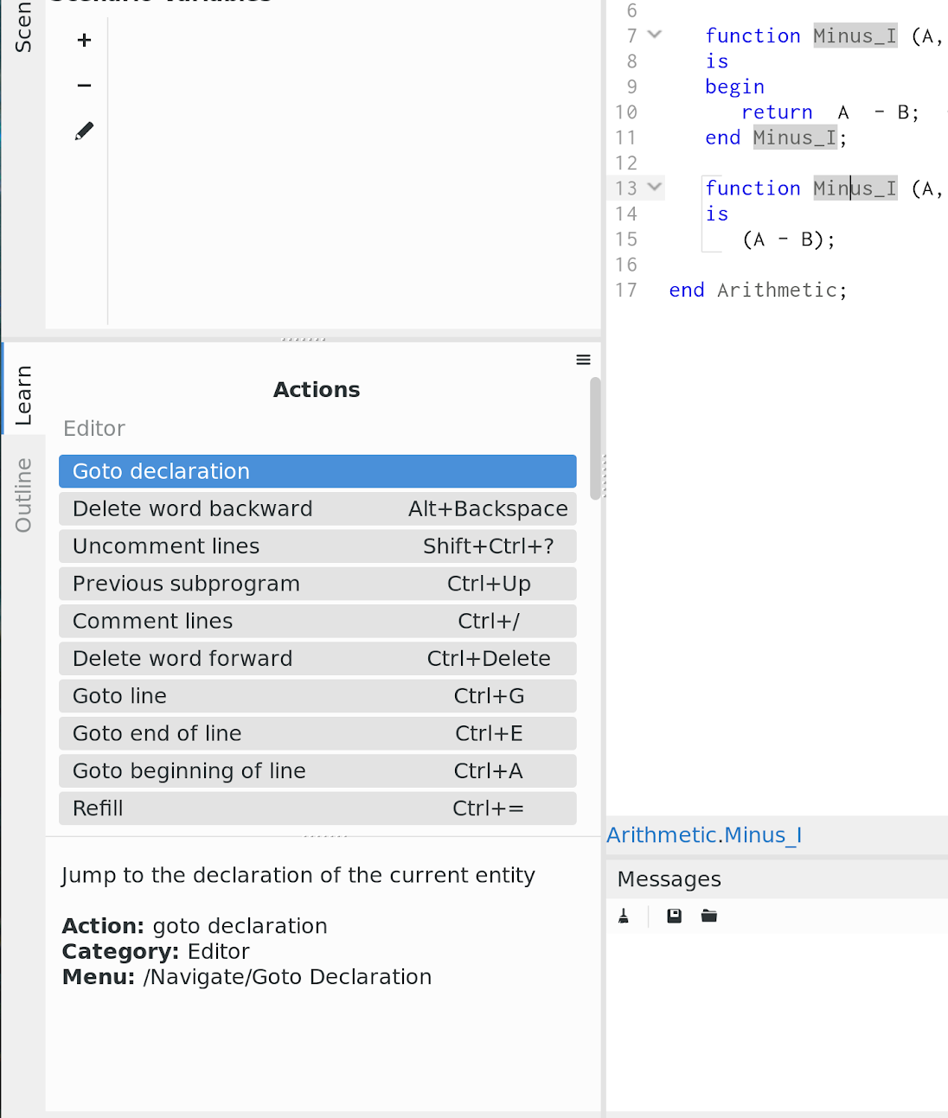
GPS
AdaCore’s main IDE
Learn view

Slide 13
GPS
Libadalang view
Improved integration with debugger
new Registers view
set values in Variables view
lazy retrieve of callstack information
Improved Scenario view
untyped variables
variables in aggregated projects
Revamp and simplification of color preferences + theme support

Slide 14
GNATbench
Eclipse Plug-In for Ada
Support for Eclipse 4.8 Photon, Wind River WorkBench 4.15
Eclipse SimRel 2018-09 under test
Improved Ada/C++ exception handling on VxWorks 7
Better integration with WorkBench
improve support for compiler with GNAT Pro C
full access to environment managed by WorkBench
New UI for runtime selection

Slide 15
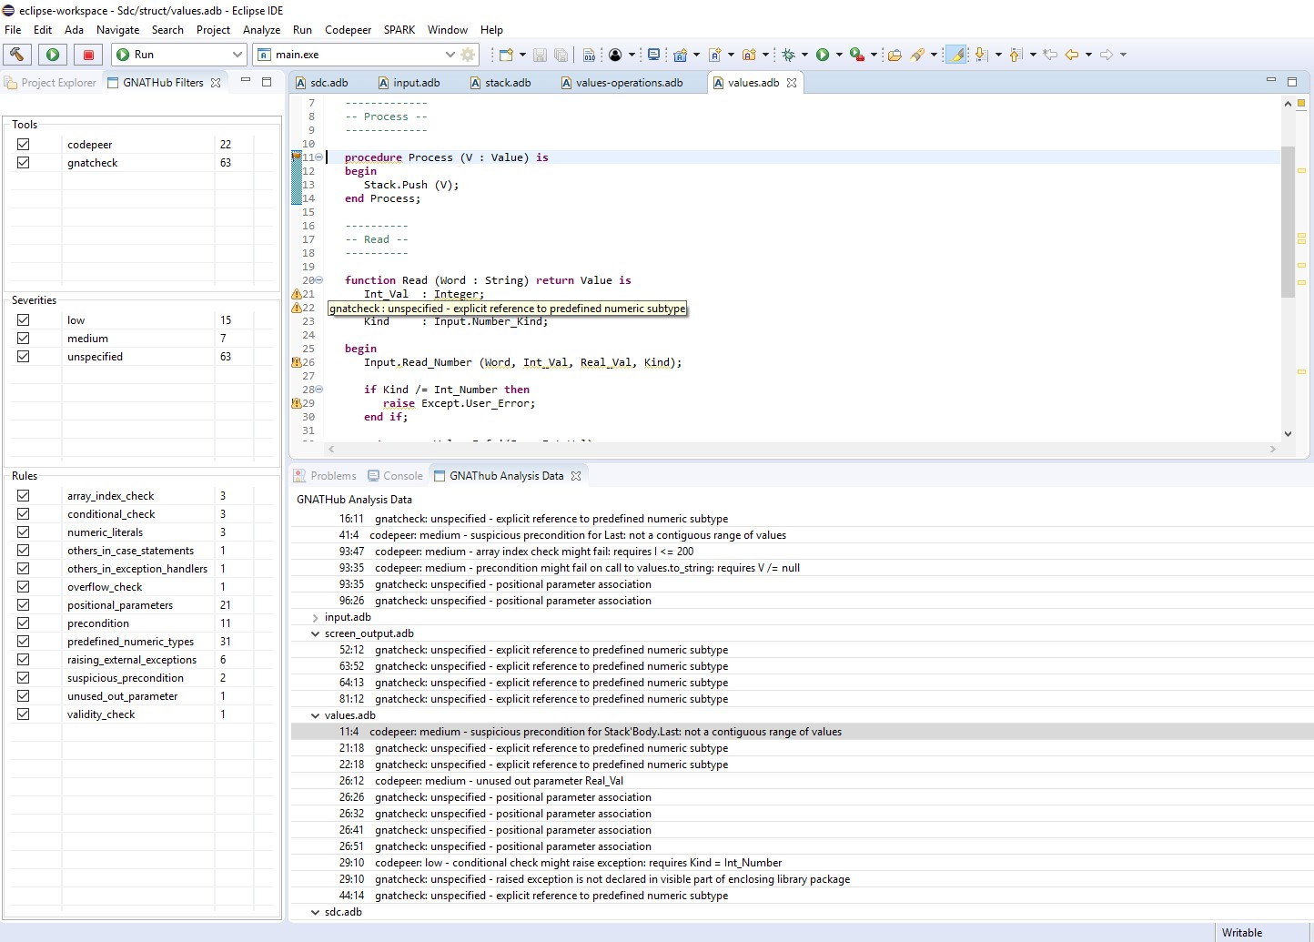
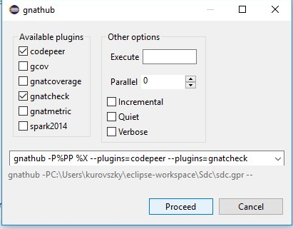
GNATbench
GNAThub integration

Slide 16
GNATdoc
Documentation Generator
Support for generics
Notes:
new tag for generic parameters
support documenting instantiations and renamings

Slide 17
GNATdashboard
GNAT Tools Aggregation and Visualization
Support for SonarQube 6.7 LTS
New Web UI, used for CodePeer (and other tools)

Slide 18
Tools

Slide 19
GPRbuild
Multipurpose GNAT builder
Removed compile command line length limitation on Windows
Recompile if GNAT toolchain version changes between compiles
Propagation of static SAL link dependencies upstream

Slide 20
GNATcheck
Qualifiable Coding Standard Checker
Many new GNATcheck rules implemented & qualified for DO178C

Slide 21
GNATcoverage
Qualifiable Code Coverage
Improved handling of pragmas wrt statement coverage
Support for programs with compressed debug info section

Slide 22
In Our Labs

Slide 23
New Elaboration Algorithm
Taking complete call graph into account
Will solve porting efforts

Slide 24
GNAT Pro C++
Cross Linux
VxWorks 6
VxWorks 7

Slide 25
GNAT LLVM
Working on plugging GNAT front-end with LLVM code generator

Slide 26
GNATcoverage
Support for source instrumentation to provide coverage everywhere

Slide 27
GPR
Active work on GPR2 library and tools

Slide 28
Libadalang and Tools
Libadalang will replace all source navigation, cross reference and refactoring capabilities in GPS and GNATbench
GNATstub, GNATmetric, GNATcheck are also being transitioned

