Slide 2
Python integration in GPS
Anthony Leonardo Gracio
October 4th, 2018

Slide 3
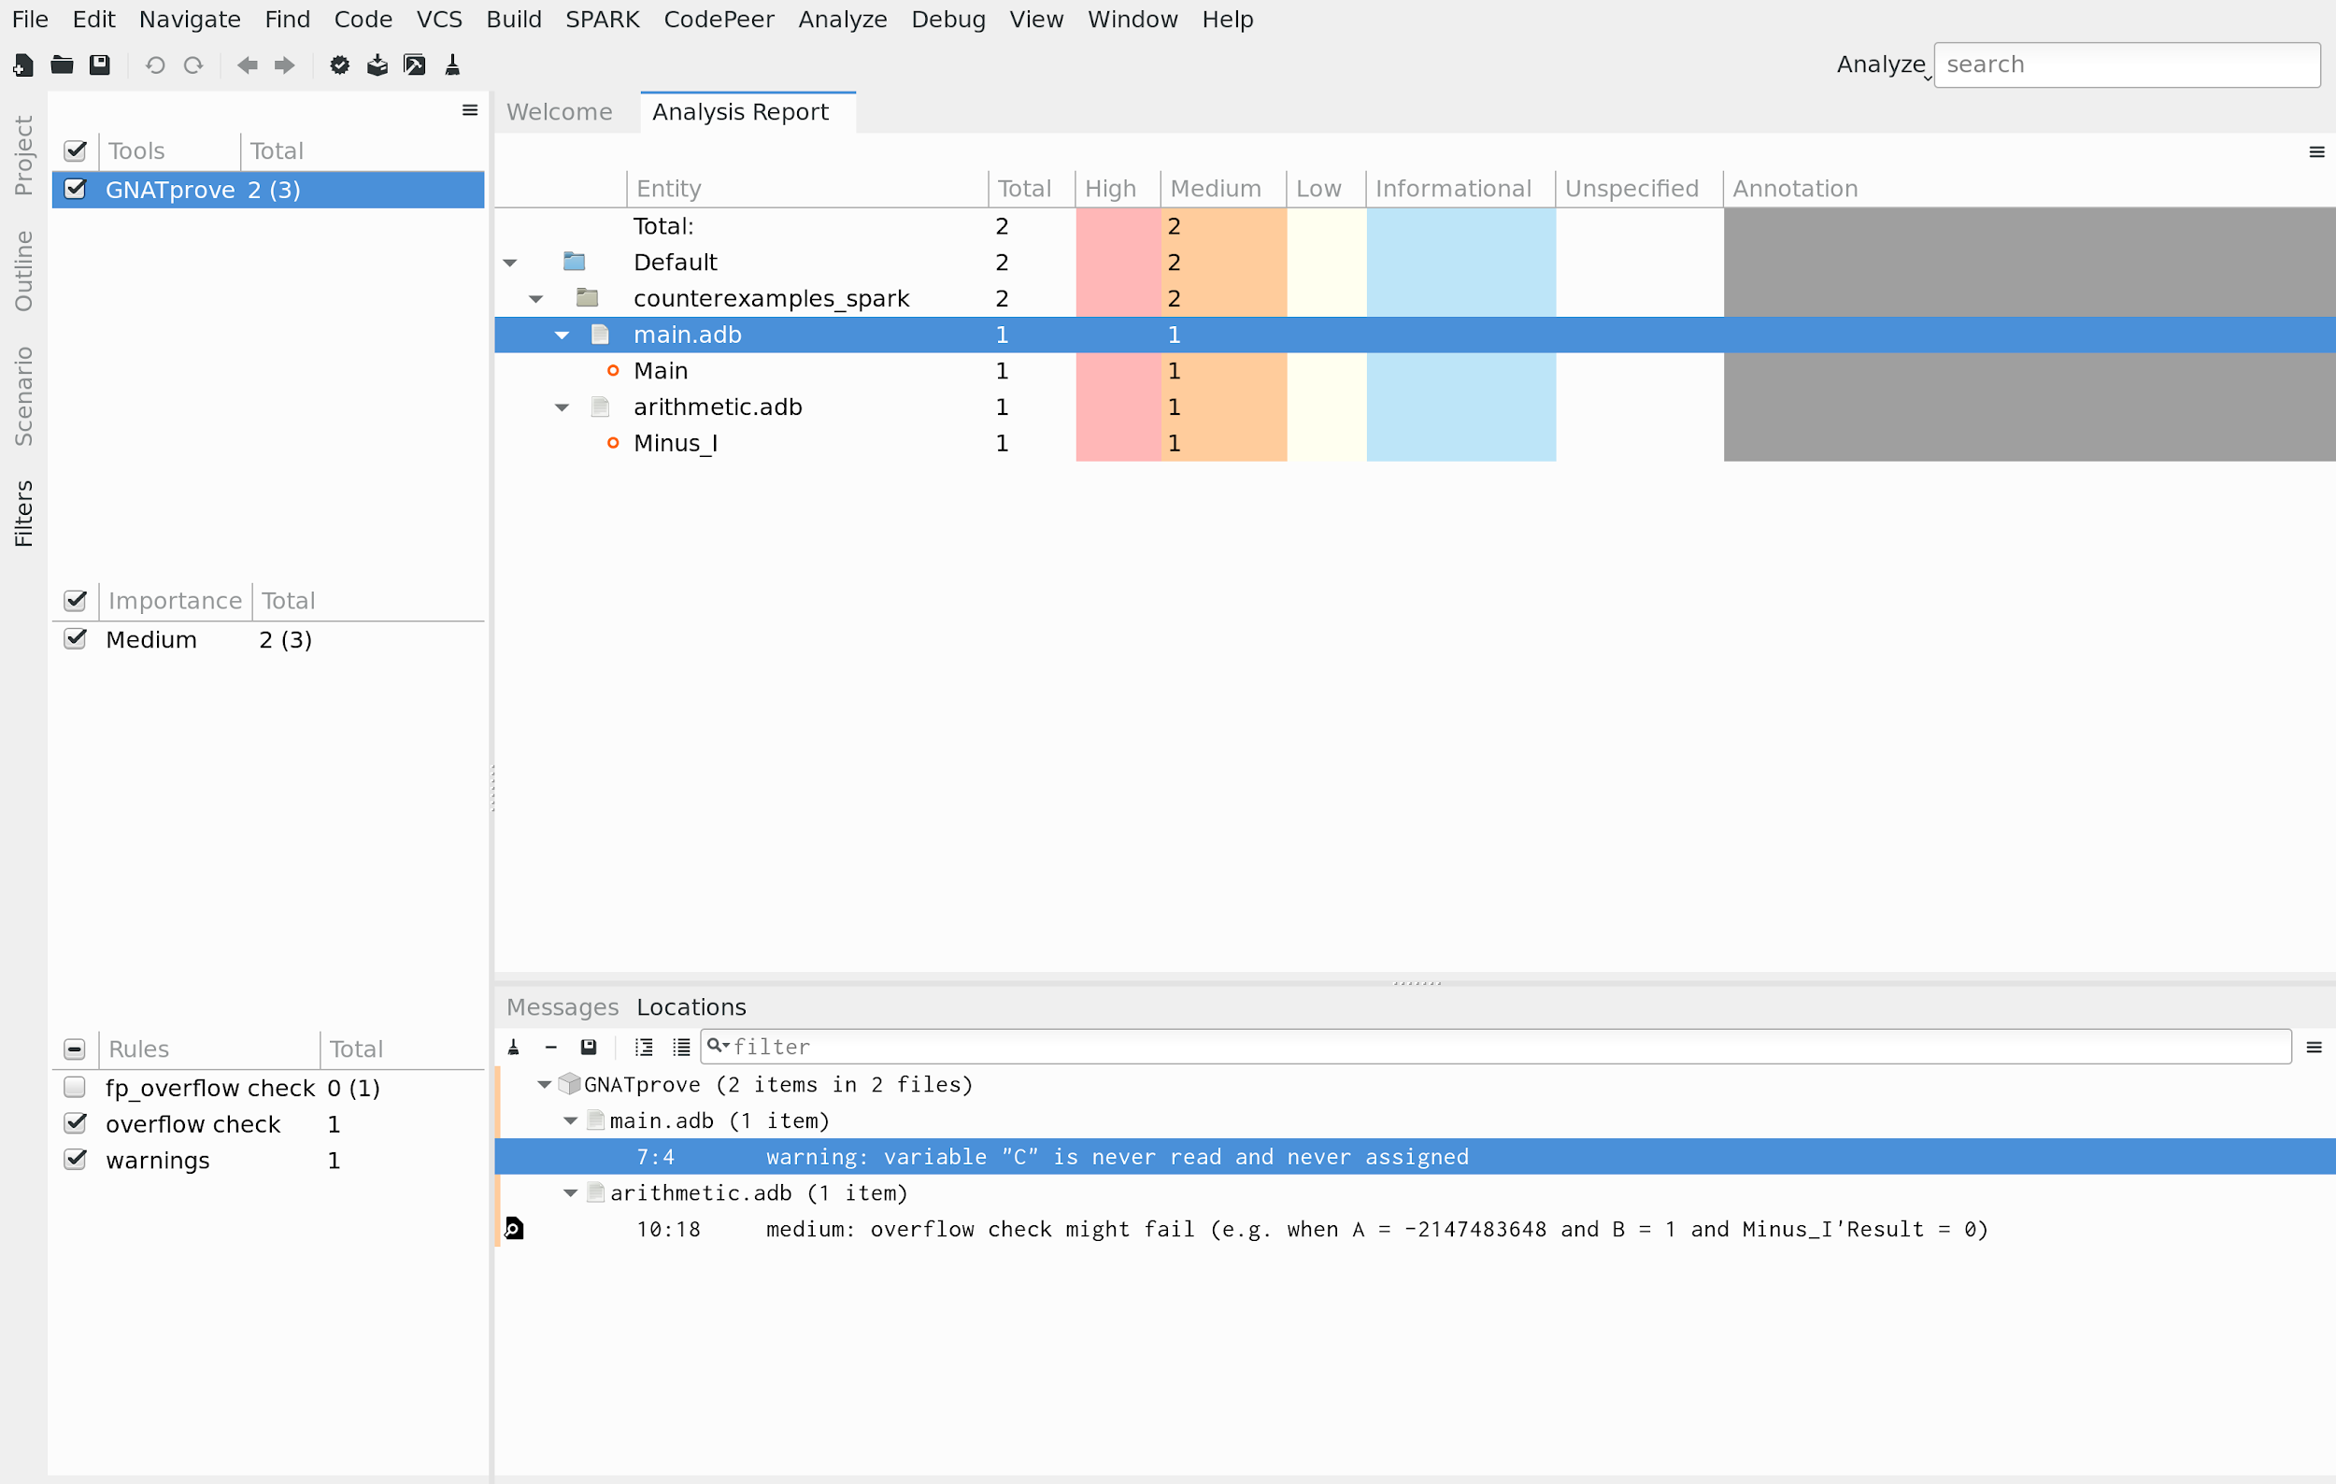
Problem: “GPS does not do what I need”
GPS comes with built-in support for some languages (Ada, C, C++...), tools (GNATprove, CodePeer...) and debuggers (GDB)
Problem: users may have some more specific needs
GNATprove integration in GPS

Slide 4
Solution: customize GPS through Python
How?
GPS Python API
The Python Console
(Python interpreter in GPS)
Python plugins specific to your project (<project>.ide.py)
Personal Python plugins
(~/.gps/plugins)
Version currently supported: Python 2.7.10

Slide 5
Demo time!

Slide 6
Future enhancements
Extend more and more the GPS Python API
Improve the GPS support for editing Python
Switch to Python 3 at some point

Slide 7
References
The GPS Python API:
http://docs.adacore.com/gps-docs/users_guide/_build/html/extending.html
The GPS Python API:
http://python-gtk-3-tutorial.readthedocs.io/en/latest
Libadalang GitHub:
http://github.com/AdaCore/libadalang
GPS GitHub:
http://github.com/AdaCore/gps

