Slide 1
Market perspective - what’s new and where are we heading?
Jamie Ayre
Thursday October 4th, Paris

Slide 2
It’s all about you
Today is your day!

Slide 3
Please pester the AdaCore staff!
We’re here to answer your questions, discuss roadmaps, don’t leave with any un-asked questions!

Slide 4
Technical team is well represented!
GNAT Pro, GPS, SPARK, CodePeer, Coverage, QGen, Libadalang, Cybersecurity, ...

Slide 5
Goodies!
Help yourself to all the collateral available (we don’t want to take it home!)

Slide 6
Focusing our strategy
Deepening our technical offer for our existing customers whilst promoting Ada to new markets.

Slide 7
Focusing our strategy
But what does that really mean? How does that translate?

Slide 8
Products for the discerning developer
GNAT Pro Assurance
C++
Services

Slide 9
GNAT Pro Assurance
Enterprise
Assurance (on 18)
18.4
18.5
18.3
18.2
18.1
18.0
18.0w
19.0w
2017
2018
2019
GNAT Pro Enterprise + a Sustain Branch
(Critical Fixes, Critical Problems Analysis)

Slide 10
Ada/C/C++ - GNAT supports them all
C++ - native platforms: Linux and Windows
C++ - support for Embedded Linux & RTOS platforms coming in 2019
Assurance available for all languages and platforms
Let us know what your plans and needs are!

Slide 11
Services for the discerning developer
Getting the most out of AdaCore tools
Getting the most out of onsite AdaCore technical expertise
Adopting and adapting the products to your environment

Slide 12
Beefing our RTOS support
VxWorks 6, 7 & 653 support
ARM
PowerPC
Intel
64 & 32 bit
C++ 2019

Slide 13
Beefing our RTOS support
PikeOS 4.1
ARM support
PikeOS 4.2
Ada Q1 2019 wavefronts
C++, let us know!

Slide 14
Beefing our RTOS support
LynxOS-178 2.2.4
x86
PPC
LynxOS Separation Kernel on Intel

Slide 15
Verify that critical code!
Rapita RVS
Vector VectorCAST

Slide 16
Focusing our strategy
Promoting Ada to new markets...

Slide 17
Teach software engineering, not coding...
Thanks to our Academic partners here today

Slide 18
Cybersecurity what does it mean?

Slide 19
Cybersecurity — How can Ada help?

Slide 20
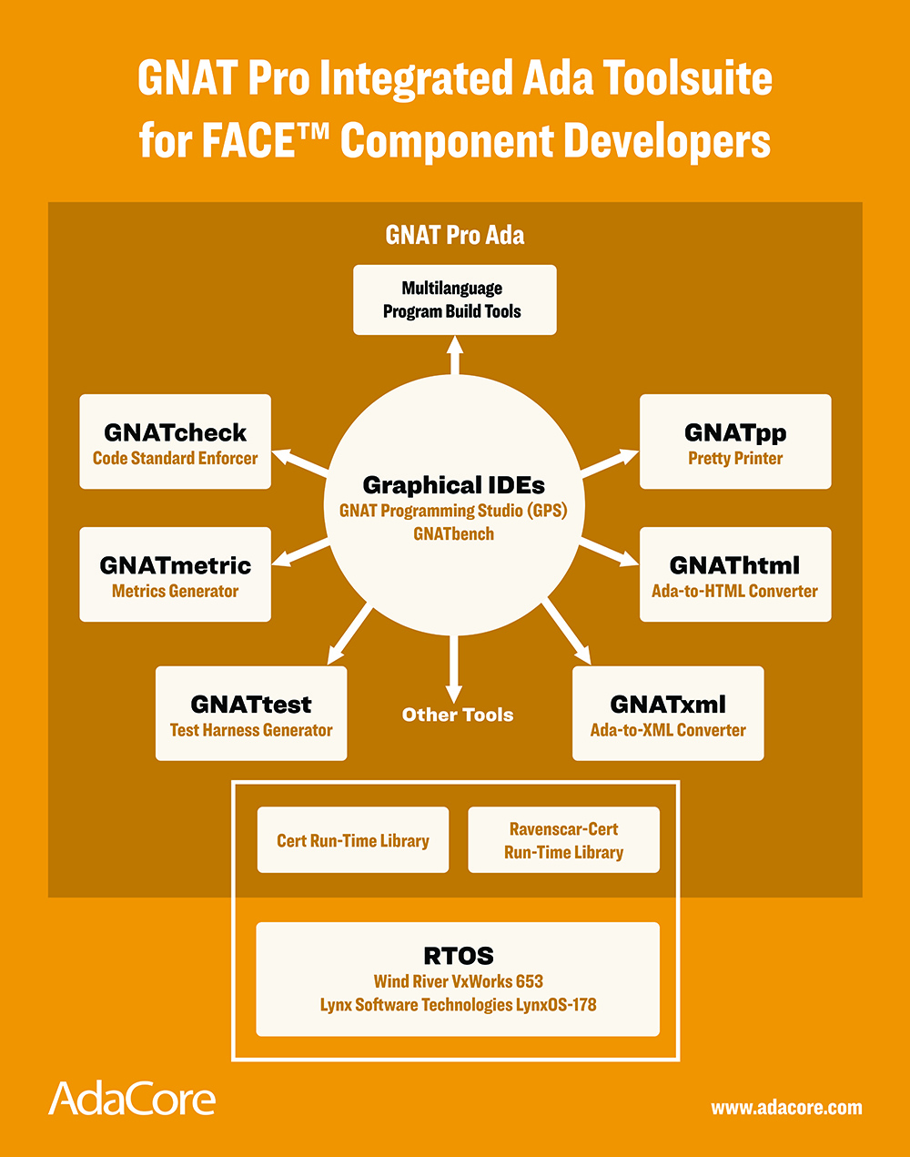
FACE what is that?

Slide 21
Ada is economical

Slide 22
So who’s convinced?

Slide 23
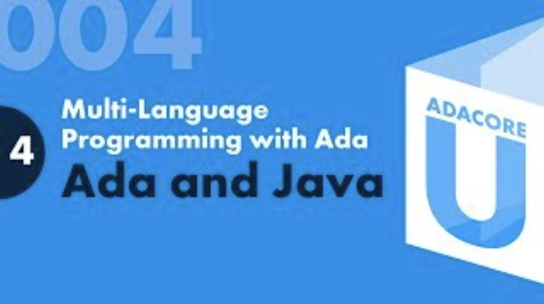
Resources to help you code

Slide 24
Public Ada Training

Slide 25
Going Green Newsletter Paper or electronic?

Slide 26
Focusing our strategy
Please continue to help us

Slide 27
Focusing our strategy
Ada continues to be our focus, exceptional customer support is our business.

