Slide 2
Cyber Security Update

Slide 3
Overview

Slide 4
Cyber Security is Many Things
Threats coming from how the system is used
Threats coming from the communication and encryption
Threats coming from the software vulnerabilities
Threats coming from the hardware vulnerabilities

Slide 5
What we target at AdaCore
Threats coming from the software vulnerabilities

Slide 6
A Multi-Tier Approach
Static Analysis
CodePeer can analyze many vulnerabilities on existing Ada code
SPARK can provide guarantees of absence of certain categories of vulnerabilities
Dynamic Analysis
Ada checks can protect against a number of vulnerabilities
Certain test techniques (fuzz testing) can trigger potential vulnerabilities
Compiler hardening
The compiler can generate “hardened” code to prevent certain kinds of attacks

Slide 8
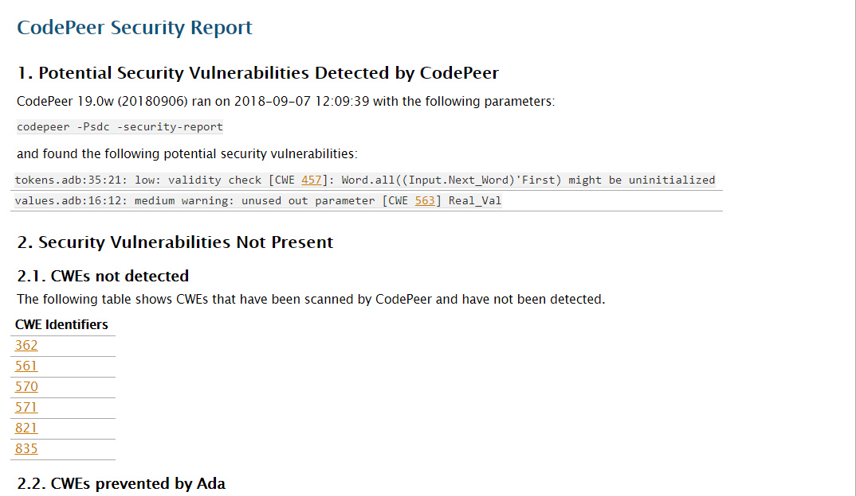
CodePeer - Security Report

Slide 9
Data Validation – Mitigations
Dynamic Mitigation
Ada run-time checking
Ada attribute X’Valid
GNAT attribute X’Valid_Scalars
GNAT validity checks -gnatV
Static Mitigation
GNAT warnings
CodePeer static analysis
SPARK Pro proof of checks
SPARK Pro proof of contracts

Slide 11
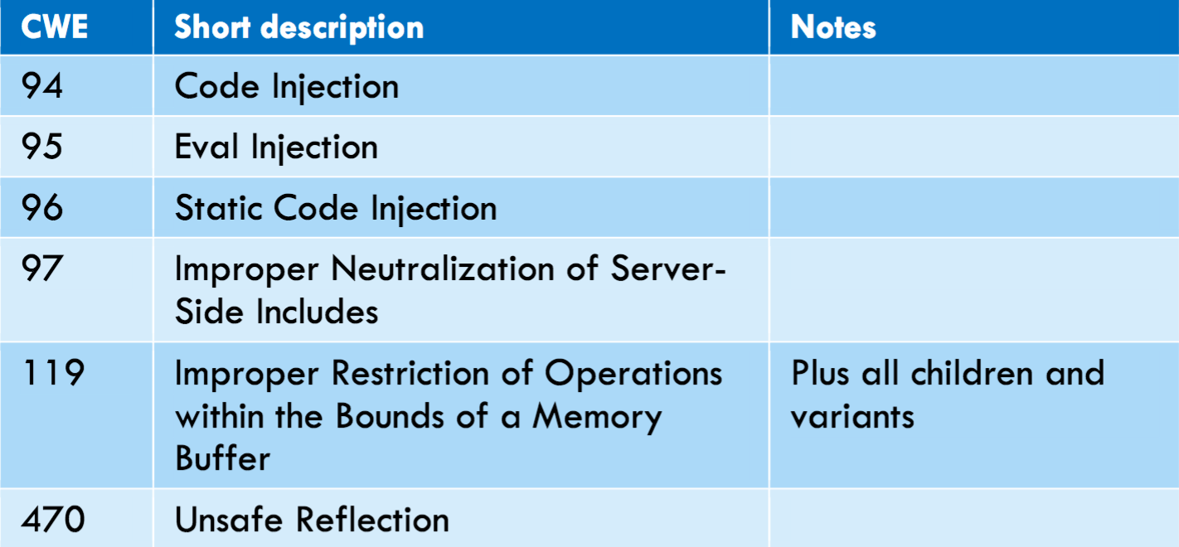
Native Code Injection – Mitigations
Ada Code Injection
No reflection/eval construct
Static linking
Execute from ROM/Flash
Machine Code Injection
Start from buffer overflow
→ Ada run-time checking
→ CodePeer & SPARK Pro

Slide 12
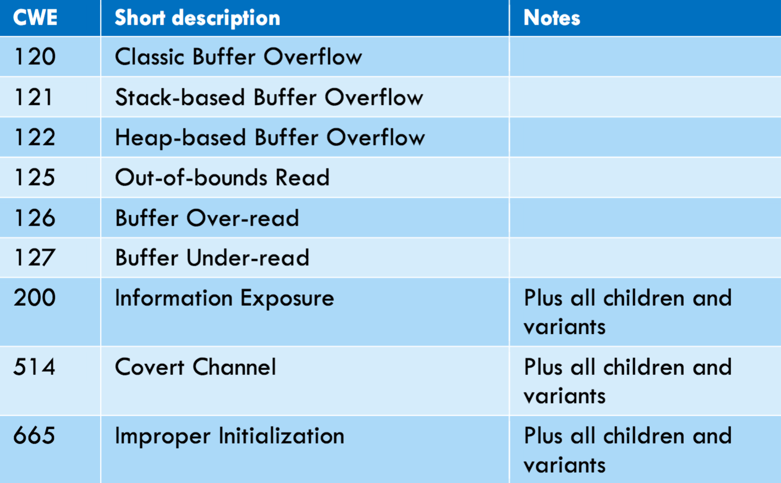
Information Leak – Mitigations

Slide 13
Information Leak – Mitigations

Slide 14
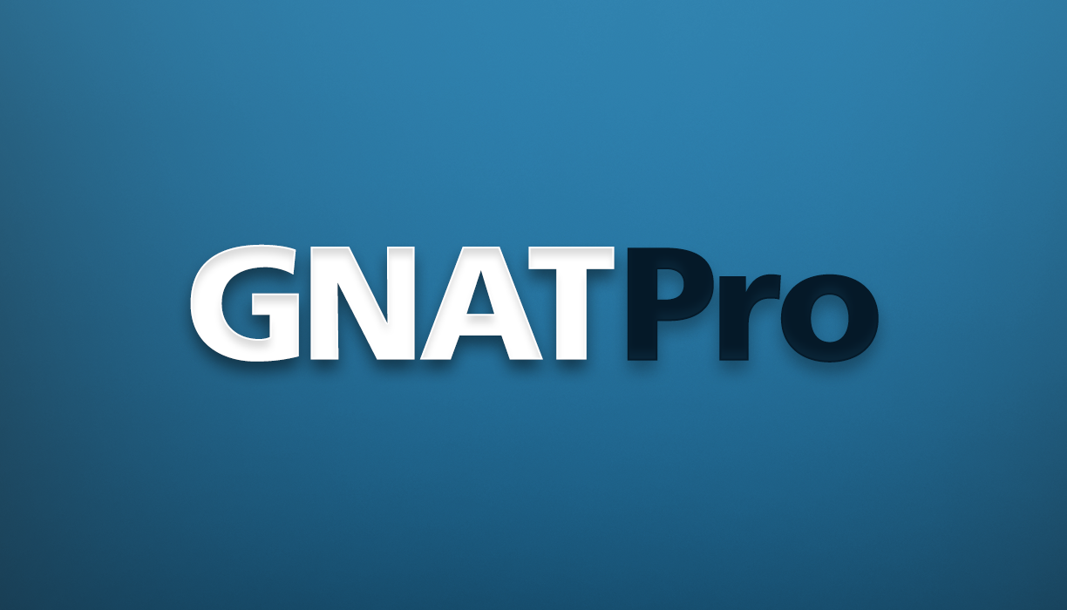
Information Leak – Mitigations
?

Slide 15
Side Channel Attacks
Data Leakage Attacks
- Key material is leaked
- Branch test on secret data
- Array read/write on secret
data
- Verification of secret is time
sensitive
- Secret data is left in memory
Fault Injection Attacks
- Bit-flip Boolean/enums
- Data corruption
- Corrupt return address/PC
- Skip branch decision
- Early loop termination
www.riscure.com/uploads/2017/08/Riscure_Whitepaper_Side_Channel_Patterns.pdf

Slide 16
(Compiler) Hardening
Data Leakage Attacks
- Detect sensitive control flow
- Start array read/write at
random index
- Force verification of secret
to take same time always
- Stack/register erasing
Fault Injection Attacks
- Represent Boolean/enums
on words
- Use data checksums
- Add explicit step counter
- Replicate branch decisions
- Verify loop termination
https://www.embecosm.com/research/secure/

Slide 17
Industrial Scenario Examples
Scenario 1:
Identifying and repairing security vulnerabilities in existing Ada codebases
Scenario 2:
Ada software development practices for increasing security
Scenario 3:
Secure Design
through SPARK
Scenario 4:
Support for Mixed Criticality Systems

Slide 18
Scenario 3 Example: Muen
The Muen Separation Kernel is the world’s first Open Source microkernel that has been formally proven to contain no runtime errors at the source code level.
https://muen.codelabs.ch/

Slide 19
Scenario 3 Example: WooKey
Software classes of attacks (e.g. buffer overflows) are mitigated using EwoK [...] providing more confidence by using the Ada safe language along with SPARK for formal verification of critical parts.
https://github.com/wookey-project

Slide 20
Take Home Messages
Use of Ada/SPARK and AdaCore tools helps prevent or mitigate a number of serious security vulnerabilities
Static analysis tools CodePeer and SPARK Pro (GNATprove) can be used to identify around 20 CWE vulnerabilities
AdaCore roadmap includes features and tools to prevent or mitigate security vulnerabilities: fuzz testing, compiler hardening, taint analysis, proven secure libraries

