Slide 1



Slide 2
GNATtest Demo
Patrick Rogers
9 May 2019

Slide 3
GNATtest In A Nutshell
An automatic generator for unit-test stubs and their driver infrastructure
Requires no changes to code under test
Supports contract-based programming tests
Helps verify OOP requirements of DO-178C
Can run tests in parallel
Can be run on command line or in scripts
Integrated into GPS
Supports native and cross platforms
Notes:
DO-178C: verifies that types satisfy Liskov Substitutability Principle, by running parent’s tests on subclasses.

Slide 4
What Can Be Automatically Generated?
Code To Be Tested
Sub-program
Sub-program
Sub-program
Sub-program
Sub-program
Generated test declaration
Visibility
Visibility
Visibility
Visibility
Visibility
Test
Test
Test
Test
Test
Unit
Test
Skeletons
Generated test body, manually completed
Call
Call
Call
Call
Call
Generated Harness

Slide 5
Fundamental Concept of the Approach
Tests are in “child” packages that have special visibility rules into “ancestor” packages
  Tests can reference hidden implementation artifacts
Thus no need to alter the code to be tested
package Parent is
...
private
...
end Parent;
package Parent.Child is
...
private
...
end Parent.Child;
Units To Be Tested
Test Declarations
package body Parent.Child is
...
end Parent.Child;
Test Bodies

Slide 6
Test Skeleton Packages Example
Note that the generated test packages’ names may conflict with application unit names
Application Package
Generated Harness
Foo
Foo.Test_Data
Foo.Test_Data.Tests
Routine1
Set_Up
Test_Routine1_nn
Routine2
Tear_Down
Test_Routine2_nn
Routine3
Test_Routine3_nn

Slide 7

Contents of Generated Directories
“harness” contains multiple projects and files
“tests” contain only the unit test skeletons
  One per application package, for you to modify
obj
Default Locations
gnattest
harness
tests
Test code to be modified
test_driver.gpr
…
test_runner.adb
Test code to be modified
Test code to be modified
Test code to be modified

Slide 8
The “Simple” Example
Included in the GNATtest examples
package Simple is
function Inc (X : Integer) return Integer;
-- function Dec (X : Integer) return Integer;
end Simple;
package body Simple is
function Inc (X : Integer) return Integer is
begin
return X + 1;
end Inc;
-- function Dec (X : Integer) return Integer is
-- begin
-- return X - 1;
-- end Dec;
end Simple;

Slide 9
Example Test Build & Run
gnattest -P simple.gpr
gprbuild -P obj\gnattest\harness\test_driver.gpr
Compile
[Ada] test_runner.adb
[Ada] gnattest_generated.ads
[Ada] gnattest_main_suite.adb
[Ada] simple.adb
[Ada] simple-test_data.adb
[Ada] simple-test_data-tests.adb
[Ada] simple-test_data-tests-suite.adb
Bind
[gprbind] test_runner.bexch
[Ada] test_runner.ali
Link
[link] test_runner.adb
obj\gnattest\harness\test_runner.exe
simple.ads:3:4: error: corresponding test FAILED: Test not implemented. (simple-test_data-tests.adb:26)
1 tests run: 0 passed; 1 failed; 0 crashed.
Generate the harness project and sub-projects for simple.gpr
Build the harness project and tests, creating “test_runner” executable
Results of “test_runner” execution
Notes:
There are no gnattest settings in this example project file (i.e., in the simple.gpr file).

Slide 10
Generated Child Package Test_Data
-- This package is intended to set up and tear down the test environment.
-- Once created by GNATtest, this package will never be overwritten
-- automatically. Contents of this package can be modified in any way
-- except for sections surrounded by a 'read only' marker.
with AUnit.Test_Fixtures;
package Simple.Test_Data is
-- begin read only
type Test is new AUnit.Test_Fixtures.Test_Fixture
-- end read only
with null record;
procedure Set_Up (Gnattest_T : in out Test);
procedure Tear_Down (Gnattest_T : in out Test);
end Simple.Test_Data;
Not to be modified
Can be modified, e.g., referencing parent private part
Null procedures, can be modified

Slide 11
Test Case Body, As Generated
with AUnit.Assertions; use AUnit.Assertions;
package body Simple.Test_Data.Tests is
-- begin read only
procedure Test_Inc (Gnattest_T : in out Test);
procedure Test_Inc_4f8b9f (Gnattest_T : in out Test) renames Test_Inc;
-- id:2.2/4f8b9f38b0ce8c74/Inc/1/0/
procedure Test_Inc (Gnattest_T : in out Test) is
-- simple.ads:7:4:Inc
-- end read only
pragma Unreferenced (Gnattest_T);
begin
AUnit.Assertions.Assert
(Gnattest_Generated.Default_Assert_Value,
"Test not implemented.");
-- begin read only
end Test_Inc;
-- end read only
end Simple.Test_Data.Tests;
Context clauses can be added
Declarative part can be modified
Statements can be modified

Slide 12
GNATtest In GPS Demo
Notes:
[Set GPS font sizes for demo]
[Start without a harness etc generated in the “simple” project included with the tool.]
Open the simple.gpr project in GPS
Invoke the Analyze->GNATTest->Generate Unit Test Setup menu
(This step opens the harness project in GPS.)
Build and Run test harness to show initial test failure
Open the Test view
Expand the “simple.ads” entry to show the “Inc:test case” sub-entry
Double-click on the “Inc:test case” sub-entry to open the source file
Change lines 45-46 to be as follows:
(Inc (41) = 42,
"Inc (41) should yield the answer to life, the universe, ...");
Press the toolbar icon to build and run the test_runner
Invoke the Analyze->GNATTest->Exit from Harness Project

Slide 13
GNATcoverage Demo
Patrick Rogers
9 May 2019

Slide 14
Code Coverage Analysis
Determining how much of the code has been tested
Goal is to identify code left unexplored, which might contain bugs
Examples
  Has every statement in the program been executed?
  Has every branch of each control structure (e.g., if and case statements) been executed?
  Has each value of each Boolean sub-expression been evaluated?
Required by certification standards

Slide 15
Code Coverage Approaches
Some solutions instrument the code
  Traces statements are inserted into the source and compiled
Some solutions use hardware stepping
  Object-level coverage achieved by probes at execution-time
Both solutions are problematic
  The final deliverable is not what was tested
  Hardware probing is expensive and time-consuming
    Requires actual target hardware
    Actual hardware is a serializing bottleneck

Slide 16
Solution: Instrument the Environment
Code is unchanged
Compiler indicates what should happen during execution
  Source Coverage Obligations (for source-level coverage)
Execution traces indicate what did happen
GNATcoverage generates reports accordingly
Cross configuration shown at right, but same general approach for all
Source-Level Coverage Example
for Cross Target
Sources
package MS1553 is
...
...
...
end MS1553;
Coverage Reports
package IO is
...
...
...
end IO;
procedure Test is
begin
...
...
end Test;
GNATcoverage
Compiler
SCOs
Linker
Trace
Data
GNATemulator
GNATcoverage
Executable
Notes:
gnatcov uses the executable as well (to perform object code cfg analysis, and read debug info) so the figure could show an arrow from the exe to the gnatcov box
An SCO is an item that designates a source program entity which must be subject to coverage checks.
The SCO conveys an entity kind, for example statement, decision or condition, together with a specific unit:line:column source location which it gets from the debug info.

Slide 17

Multiple Ways To Produce Traces
executable
$gnatcov run …
Host
Target Hardware
Target Emulator
Native
Board &
Probe
GNATemulator
Valgrind or
DynamoRIO
proprietary trace
$gnatcov convert …
  0xaf154..0xaf168, branch taken
  0xae670..0xaf674, fallthrough
  ...
Binary Trace File
Notes:
In order to produce the execution traces we need to run the tests inside of an instrumented environment.
On native targets we transparently invoke another tool to produce the traces.
For Linux we can use Valgrind, for Windows we use DynamoRIO and for other targets we use GNATemulator which is a special version of qemu.
We can achieve similar trace execution by pulling the trace information from a probe connected to the target hardware.
The trace files are binary but can be displayed textually via “dump-trace” switch

Slide 18
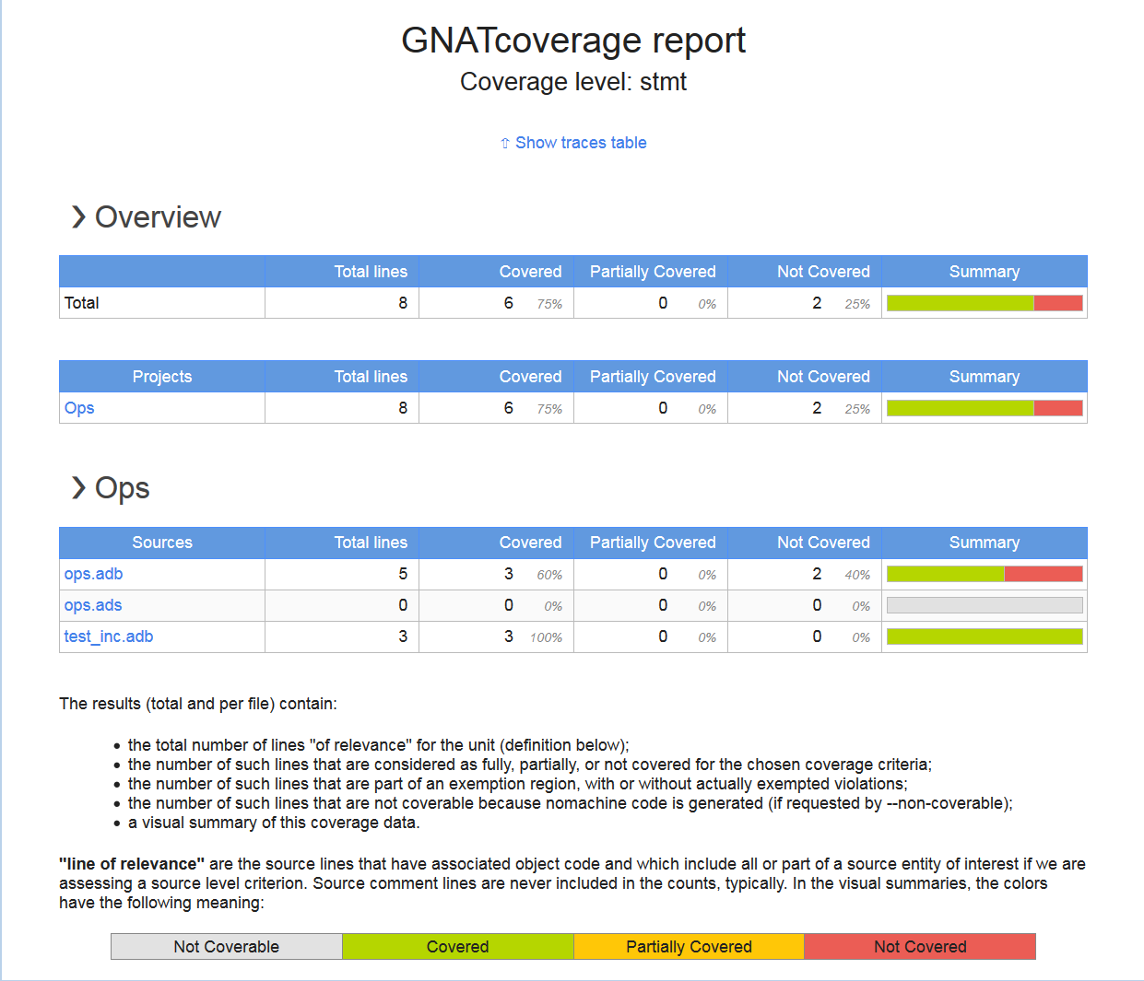
Producing Coverage Reports
  0xaf154..0xaf168, branch taken
  0xae670..0xaf674, fallthrough
  ...
Binary Trace File
Coverage Kind (stmt, branch, …)
$gnatcov coverage …
Output Format
Annotated
Source
Violations
Report
Dynamic HTML
ops.adb:
60% of 5 lines covered
Coverage level: stmt
1 .:
2 .: package body Ops is
3 .:
4 .: procedure Apply (Op : Op_Kind; X : in out Integer) is
5 .: begin
6 +: case Op is
7 +: when Increment => X := X + 1;
8 -: when Decrement => X := X - 1;
statement "X := X - ..." at 8:28 not executed
9 .: end case;
10 .: end Apply;
11 .:
12 .: procedure Assert (T : Boolean) is
13 .: begin
14 +: if not T then
15 -: raise Program_Error;
statement "raise Pro..." at 15:10 not executed
16 .: end if;
17 .: end Assert;
18 .:
19 .: end Ops;
gnatcov coverage -...
** COVERAGE REPORT **
===========================
== 1. ASSESSMENT CONTEXT ==
===========================
Date and time of execution: 2019-05-06 20:54:01.36
Tool version: XCOV 20.0w (20190211)
Command line:
...
Coverage level: stmt
Trace files:
gnatcov_demo\obj\gnatcov\test_inc.trace
program : gnatcov_demo\obj\gnatcov\test_inc.exe
date : 2019-05-06 20:31:42
tag :
============================
== 2. COVERAGE VIOLATIONS ==
============================
2.1. STMT COVERAGE
------------------
ops.adb:8:28: statement not executed
ops.adb:15:10: statement not executed
2 violations.
=========================
== 3. ANALYSIS SUMMARY ==
=========================
2 STMT violations.
** END OF REPORT **
ops.adb.xcov
Notes:
--annotate speciﬁes the desired output report format (=xcov for annotated sources in text format, =dhtml for annotated sources in html format, with colors, a toplevel and per-project indexes, sortable columns ..., =report for a synthetic list of coverage violations)

Slide 19
GNATcoverage Benefits
Supports both source and object coverage
  Statement, decision, and MCDC coverage for source level
  Instruction and branch coverage for object level
  For all variants of Ada and C supported by compilation toolchain
Supports execution on host, bare-metal, & RTOS
Emulator configuration benefits
  Addresses scarcity of target hardware
  No host/target ISA source differences (endianess, sizing, etc.)
  Scalable, can be put on every developer’s desk
Integrated with GPS and project files
Notes:
Modiﬁed Condition/Decision Coverage

Slide 20
Advanced Capabilities
Coverage Consolidation
  Computing results for a set of execution traces
  When several executions are required to exercise different scenarios in the application program
  Doesn’t require keeping the binaries from each scenario
Exemption Regions
  Code regions for which coverage violations are expected
  User-defined

Slide 21
GNATcoverage
In GPS
Demo
Notes:
[Set GPS font sizes for demo]
Make sure there is no gnatcov subdir under the obj dir
Open the Ops project in GPS
Ensure Build Mode scenario is GNATCOV!!!!!!
Build
Analyze->Coverage->GNATcov->Run
Analyze->Coverage->GNATcov->Coverage
In the coverage report, expand the ops.adb entry
Double-click on the (procedure) Apply entry

Slide 22
Questions?

