Slide 2
C/C++
Yes, we do those languages too.
Robert Tice
Technical Account Manager

Slide 3
Why AdaCore and C/C++?
Software Module
C
Ada
C++
OS | RTOS | Baremetal

Slide 4
C
Ada
C++
Compiler Front-end
GCC
Compiler Back-end
Binary

Slide 5
But I already have a C/C++ compiler...
Provided by OS | RTOS
C
C++
Ada
GCC version X
GCC version Y
mylib.so: undefined reference to `std::__cxx11::foo_bar
x300 more GCC compatibility errors in the output log
GCC Linker
GCC Linker
Provided by AdaCore
Binary

Slide 6
But I only have C/C++...
AdaCore is a compiler company
Expert language support
Expert compiler support
Same support guarantees you expect from AdaCore
Up to date language version support
C++17, and C11

Slide 7
Platform Support
 | Native (x86) |  | Embedded (PowerPC, ARM, x86, RISCV)
 | Linux | Windows | Linux | Bare Metal | VxWorks 6 | VxWorks 7 | Lynx178
C
C++

Slide 8
GNAT Pro Assurance for C/C++
Enterprise
Assurance (on 18)
18.4
18.5
18.3
18.2
18.1
18.0
18.0w
19.0w
2017
2018
2019

Slide 9
GNAT Pro Assurance A solution for long term maintenance
Critical Bug Fixes
Silent code generation error
False negative
Issues hindering production of certification evidence
Active Known Problem Analysis
Analysis of problems identified in other versions
Analysis of problems identified in the community
Additional categorization and justification material
Sustain impact analysis justifications

Slide 10
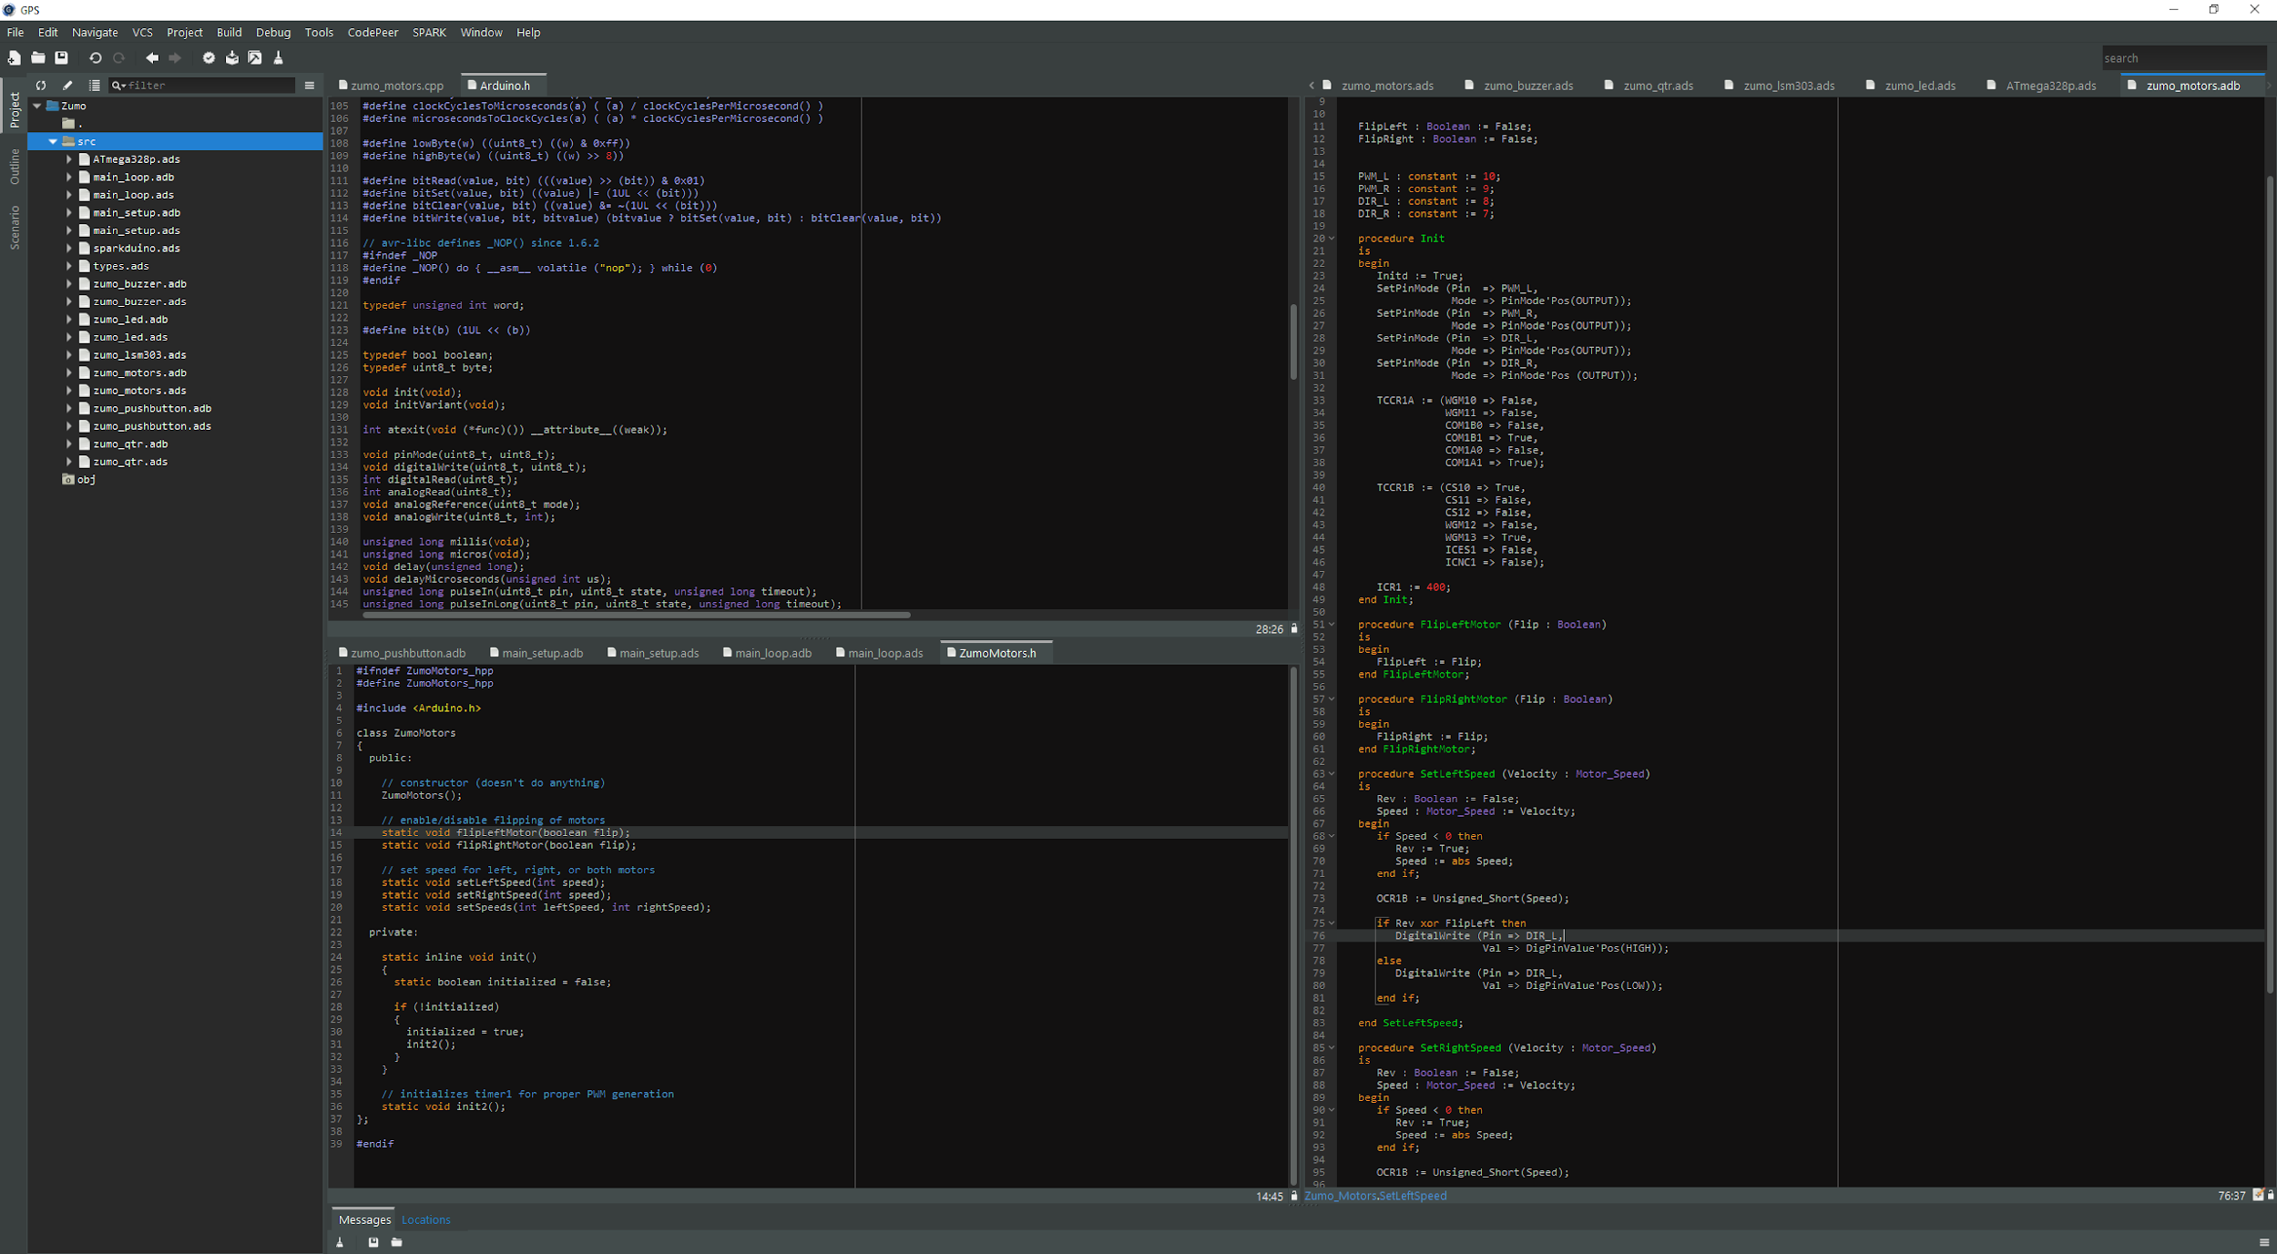
GNAT Programming Studio
Mixed language environment for C, C++ and Ada
Smart edition
Source code navigation (integration with clang)
Integration with build & debug

Slide 11
GNATcoverage
Ada & C Support
HOST
Pure
Functional Test
Windows, Linux Bare Metal ARM / PowerPC
VxWorks 6 PowerPC
Source to Object Traceability Study
GNATemulator / Valgrind / dynamiRIO
Coverage Information
Sources
Executable
Pure
Functional Test
Coverage Data
(no instrumentation)
Statement Decision MC/DC
Ada 83 / 95 / 05 / 2012 C 99
Lauterbarch / iSystems
TARGET

Slide 12
GNATstack
Identify worst case of stack usage for each entry point
Available for Ada (up to Ada 2012) and C
Information provided statically
Manual information needs to be provided for
System calls
Recursive calls
Dynamic frames
DO-178 qualification material is available

Slide 13
Endianness Specification
Specify endianness of a data structure regardless of processor
Compiler handles endianness conversion
Ideal for porting from PowerPC to x86 / ARM when communication layers are endian-specific
struct s {
int a, b;
} __attribute__((scalar_storage_order("big-endian")))
variable;

Slide 14
Ada/C++ Exception Propagation
Calls
Calls
C++
Ada
C++
exception
when others =>
…
raise Y;
catch (…) {
}
throw X;

Slide 15
Mixed Language Build
GPRbuild can build mixed language applications
Other compilers can be configured through GPRconfig
project Mixed is
for Languages use (“Ada”, “C”);
end Mixed;

Slide 16
Ada & C bindings
Importing C code from Ada
Importing Ada code from C
procedure C_Proc; pragma Import (C, C_Proc, "c_proc"); | void c_proc (void) { // some code }
procedure Ada_Proc; pragma Export (C, Ada_Proc, "ada_proc"); procedure Ada_Proc is begin -- some code end Ada_Proc; | extern void ada_proc (void);

Slide 17
Some more Ada & C bindings
Easy to get wrong…
Type R1 is record V : int; end record with Convention => C; procedure F1 (P : R1); pragma Import (C, F1, "f1"); | struct R1{ int V; }; void f1 (R1 p);
Type R1 is record V : int; end record with Convention => C_Pass_By_Copy; procedure F1 (P : R1); pragma Import (C, F1, "f1"); | struct R1{ int V; }; void f1 (R1 p);

Slide 18
Using the Binding Generator
From C to Ada
From Ada to C
gcc –fdump-ada-spec <header files>
gcc –gnatceg <specification files>

Slide 19
Ada/C++ Inheritance
procedure P (V : T’Class) is
begin
V.Method;
end P;
T C++ Base Type
Method
T2 Ada Derived Type
void P (T & V) {
V.Method();
}
Override Method

Slide 20
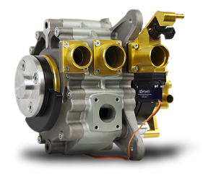
Simulink to C Code Generation
QGen
QGen Code Generation (SPARK Ada or MISRA C)
Target Debugger
Simulink®, StateFlow®
Safe subset of embedded blocks (~120)
Portable across versions

Slide 21
Ada/SPARK to C Code Generation
GNAT Common Code Generator (CCG)
Develop formally proven code in SPARK and build with C toolchain
C code to be considered as compilation artifacts
Similar to assembly or internal compiler trees
Not meant to be maintainable
Removes constraints on the target architecture supported
Runtime support similar to bare metal Zero Footprint Profile

