Slide 2
Future Airborne Capability Environment (FACE™) Support
Michelle Ricardo
May 9, 2019

Slide 3
What is FACE?
FACE is a government/industry approach aimed at developing a software and business strategy that promotes interoperability and interchangeability between software systems.
Technical standard is based on well-defined common interfaces
Business strategy encourages the development and deployment of FACE conformant products
Website: www.opengroup.us/face
Notes:
Future Airborne Capability Environment (FACE™) - as the name implies - is focused on avionics applications, specifically embedded military avionics applications
FACE does not guarantee fitness for purpose or compliance with safety / security standards

Slide 4
In other words...
FACE focuses on standardized interfaces that will lead to portable and reusable software components across systems and vendors
Notes:
Over time - light bulbs have changed increasing their efficiency. However, their manufacturers maintain the basic design of the bulb’s electric foot (makes contact) and the screw thread (fits into the lamp). Reuse of older lamps with newer bulb technology.

Slide 5
Who is working on FACE?
Sponsors
Principals
Associates
7 Organizations
Air Force Life Cycle Management Center
Boeing
Collins Aerospace
Lockheed Martin
NAVAIR
Raytheon
US Army PEO Aviation
18 Organizations
AdaCore
GE Aviation Systems
General Dynamics
Harris Corporation
Honeywell Aerospace
Northrop Grumman
Sikorsky Aircraft
US Army CCDC Aviation & Missile Center
Wind River
64 Organizations
CMC Electronics
L3 Technologies
LDRA Technology
Leidos
Lynx Software
OAR Corporation
SAIC
Vector Software
Verocel
Complete Member List www.opengroup.org/content/future-airborne-capability-environment-face/member-list

Slide 6
AdaCore and FACE
AdaCore is a Principal Member of The Open Group’s FACE Consortium.
The Consortium defines the FACE Technical Standard.
Our contributions include reviewing the various versions of the FACE Technical Standard:
Helping to formulate effective policies/procedures related to OSs and run-time libraries
Working towards incorporating Ada 2012 capability sets, so developers can use contract-based programming and other modern features
Assisting in the definition of the IDL-to-Ada mapping
Notes:
Everything we do at AdaCore is centered around helping developers build safe, secure and reliable software.
AdaCore has extensive knowledge and experience with avionics software standards, including safety standard DO-178
AdaCore has also sponsored FACE meetings and presenting papers / conducting demos at FACE Technical Interchange Meetings and provided comprehensive Ada development environments with run-time libraries that support the Ada Safety capability sets

Slide 7
FACE Support in AdaCore Tools
Ada is unique in its support for portable, reliable and efficient code.
The language was designed for real-time embedded systems and has a long and successful track record in military/aerospace projects.
AdaCore offers technology and support for FACE components, including:
Development environments (GNAT Pro Enterprise/Assurance)
Run-time libraries (VxWorks 653 and LynxOS-178)
Capability set enforcement (GNATcheck safety capability sets)
Supplemental tools (CodePeer, SPARK Pro, GNATcoverage)
Safety certification (DO-178B/C certification material and qualification material for other GNAT Pro tools)
Notes:
Run-time libraries. GNAT Pro cross compilers for several target platforms include run-time libraries for the Ada Safety-Extended and Safety-Base & Security capability sets.

Slide 8
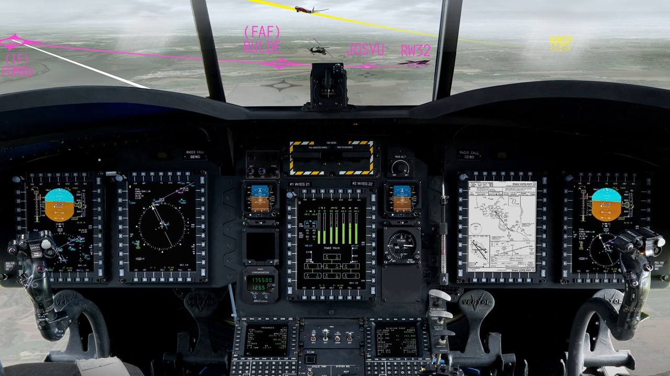
FACE Example - Collins MFMS-1000
Notes:
Mission Flight Management Software (MFMS-1000) is certified conformant to the FACE Technical Standard - resulting in a hardware-agnostic solution portable to any avionics system.
Lynx Software Technologies RTOS - and they are using Ada and AdaCore tools

Slide 9
FACE Example - Collins MFMS-1000
Collins contracted to equip military aircrafts with the MFMS-1000:
U.S. Navy (Naval Air Systems Command (NAVAIR))
U.S. Marine Corps (Air Combat Electronics program office (PMA-209))
“This will be the first time military aircraft will have a low-risk means to implement RNP-RNAV compliance without the need for an expensive and time-consuming avionics system upgrade.”
-Heather Robertson, Senior Director for Rockwell Collins
Notes:
Mission Flight Management Software (MFMS-1000) is certified conformant to the FACE Technical Standard - portable to any avionics system.
(Safety-critical) Required Navigation Performance - Area Navigation (RNP-RNav)
Reduced pilot workload and training - smooth, global interoperability between civil and mission airspace
Collins data sheet - https://www.rockwellcollins.com/-/media/files/unsecure/products/product-brochures/computing/software-applications/mfms-1000-ds.pdf?lastupdate=20180326191427

Slide 10
Helping Developers Build Software that Matters
Notes:
AdaCore is committed to the success of the FACE approach, and both the Ada language and the company’s product offerings directly support the initiative’s objectives.

Slide 11
Future Airborne Capability Environment (FACE™) Support
Michelle Ricardo
ricardo@adacore.com

