Slide 2
Update & Roadmap

Slide 3
Established Ada market
“Helping to preserve investments done with Ada”
“Provide new cost-effective ways to develop reliable software”
Emerging Ada Market

Slide 4
Markets
Avionics
Simulation
Radar
Missiles
ATM
Naval C&C
Land C&C
Communications
Drones
Automotive
Medical Devices
IoT
Industrial Automation
Energy

Slide 5
GNAT Pro

Slide 6
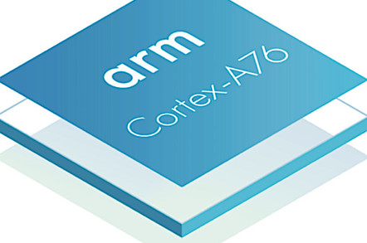
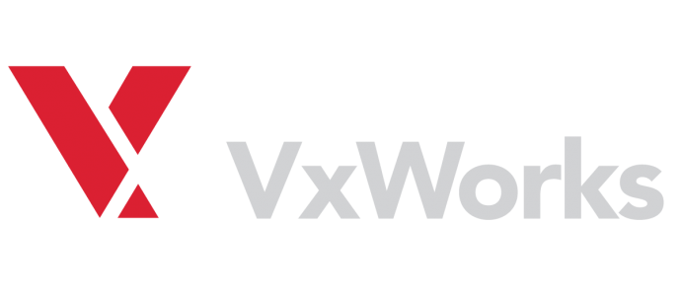
GNAT Pro New Ports Highlights

Slide 9
GNAT Pro C and C++
 | Native (x86) |  | Embedded (PowerPC, ARM, x86, RISCV)
 | Linux | Windows | Linux | Bare Metal | VxWorks 6 | VxWorks 7 | Lynx178
C
C++

Slide 10
Libadalang released with 19
A library that allows users to query/alter data about Ada sources
Both low & high level APIs:
What is the type of this expression?
How many references to this variable?
Give me the source location of this token
Rename this entity
Multi-language: Easy binding generation to other languages/ecosystems
Today: Python, Ada, C
Easy scripting: Be able to create a prototype quickly & interactively

Slide 11
Libadalang example: Semantic
Code | Outputs
with Ada.Text_IO; use Ada.Text_IO; procedure Main is function Double (I : Integer) return Integer is (I * 2); function Double (I : Float) return Float is (I * 2.0); begin Put_Line (Integer'Image (Double (12))); end Main; | function Double (I : Integer) return Integer is (I * 2);
double_call = unit.root.find( lambda n: n.is_a(lal.CallExpr) and n.f_name.text == 'Double' ) print double_call.f_name.p_referenced_decl.text

Slide 12
GNAT Pro Assurance
Enterprise
Assurance (on 19)
19.4
19.5
19.3
19.2
19.1
19.0
19.0w
20.0w
2019
2020
2021

Slide 13
Other GNAT Highlights
Spectre V2 mitigation (-mindirect-branch and -mfunction-return switches)
Link time speedup on Windows for large executables with multiple DLLs
Full Ada 2012 syntax for C/C++ binding produced by -fdump-ada-spec
Improved suppression of access-before-elaboration checks and warnings
AWS improvements
Enhanced interoperability with Apache CXF for document/literal WSDL and generated SOAP messages.
Improved session handling security by using a configurable private hash.

Slide 14
Static Analysis

Slide 15
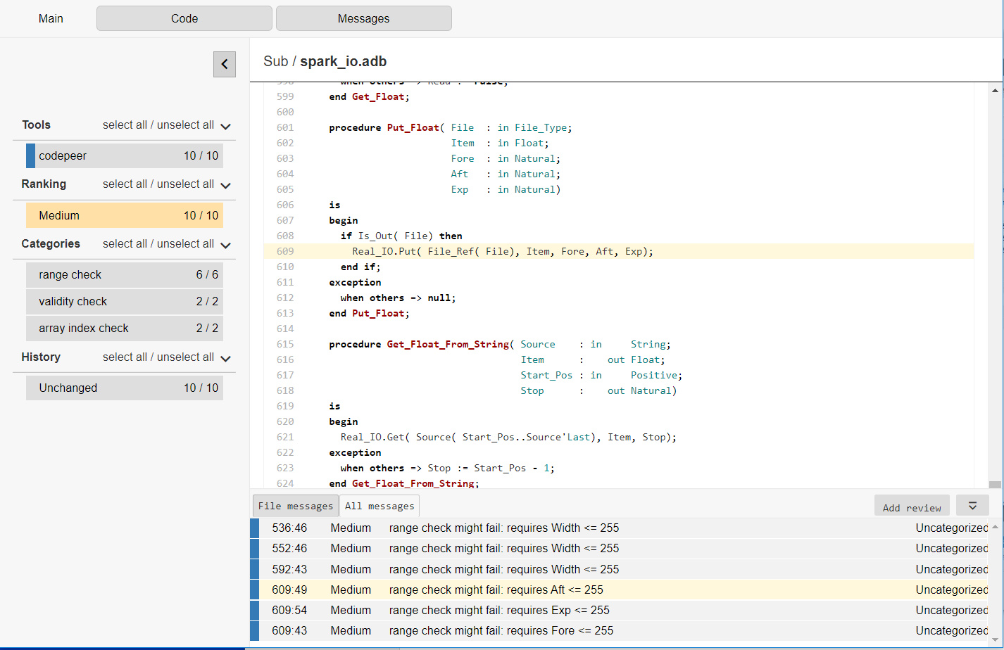
CodePeer - New Web Interface

Slide 16
CodePeer - New Entry Level
Level 0 with lal checkers
New default
Very few false positives
Very fast analysis
Will allow users to write their own checkers in the future

Slide 17
SPARK 2014
SPARK is a software development technology specifically designed for engineering high-reliability applications.
A formally-defined programming language supporting static analysis
Plus a set of tools to perform those analyses
Based on statically provable contracts + testing

Slide 18
SPARK 2014 plans
Support for access types
Fine grain initialization proof
Improvements to counter-examples
ISO-26262 (Automotive) qualification

Slide 19
Services

Slide 20
Mentorships Technology Adoption Services

Slide 21
In the lab

Slide 22
Ada and GPUs (1/2)
core | core | core
core | core | core
core | core | core
Offload computations

Slide 23
Ada and GPUs (2/2)
procedure Test_Cuda
(A : Float_Array; B, C : Float_Array)
is
begin
A (CUDA_Get_Thread_X) := B (CUDA_Get_Thread_X) + C (CUDA_Get_Thread_X);
end Test_cuda;
CUDA / OpenCL option
A, B, C : Float_Array;
begin
pragma CUDA_Kernel_Call (Grid’(1, 1, 1), Block’(8, 8, 8));
My_Kernel (A, B, C);
procedure Test_OpenACC is
A, B, C : Float_Array;
begin
-- initialization of B and C
for I in A’Range loop
pragma Acc_Parallel;
A (I) := B (I) + C (I);
end loop;
end Test_OpenACC;
OpenACC option

Slide 24
Other Significant Efforts
LLVM-based compilers experiments
GNATcoverage support for instrumented code (as opposed to instrumented emulation)

Slide 25
New Ada Adopters

Slide 26
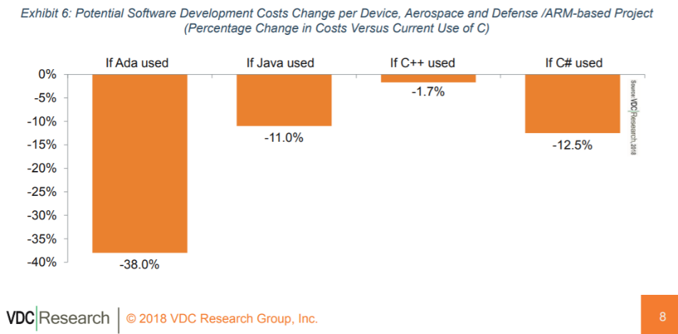
Why do they care about Ada?
Source: https://www.adacore.com/uploads/techPapers/Controlling-Costs-with-Software-Language-Choice-AdaCore-VDC-WP.PDF

